Slide 1

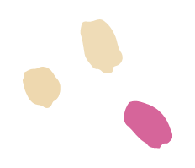
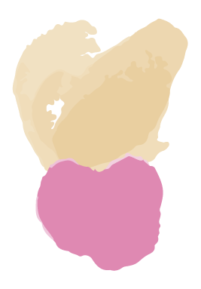
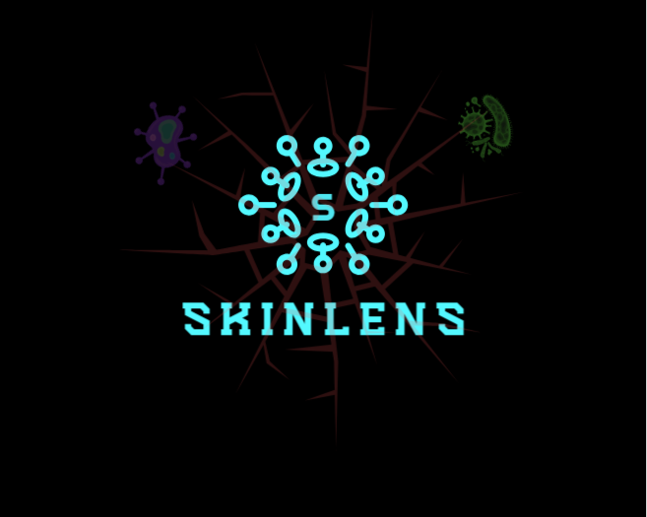




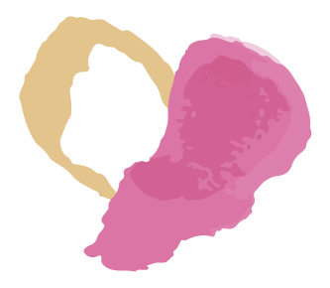
SkinLens
Team Biased
Your Personal Dermatologist

Slide 2
AGENDA
02
01
03
04
Roles and Responsibilities
Improvements
Problem Statement
Project Description
Working Agreement
Personas
MVP
Project Design
Technologies
Algorithms
Diagrams
05
06
07
08
Project backlog
Sprint 1 Summary
Sprint 2 Summary
Sprint 3:
Stories
Test cases
Completed
Not Completed
Sprint 3 Metrics:
Velocity
Burndown Chart
Committed Ratio
Sprint 3 Retrospective
Project Demo and APIs

Slide 3
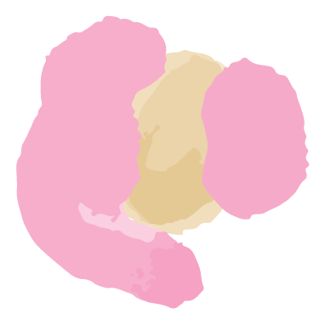
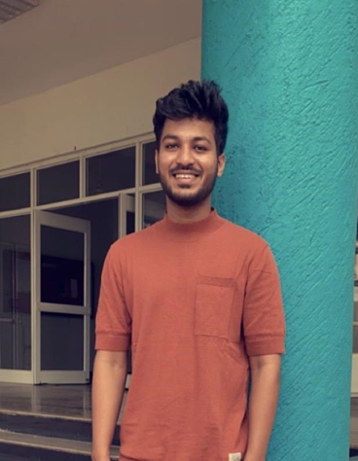
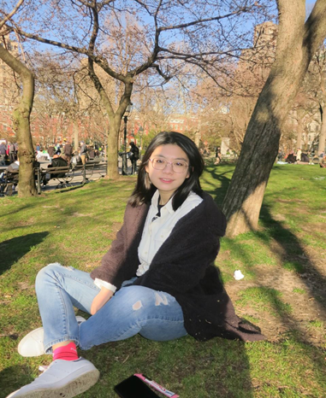


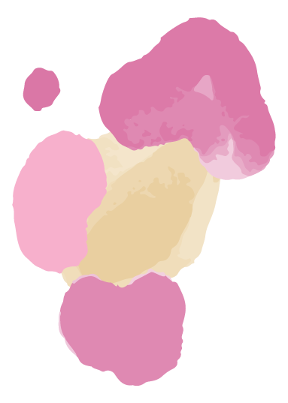
Roles and Responsibilities
MOHAMMAD ZAID
TEAM LEADER/DEVELOPER
ZHUOWEN YAN
SCRUM MASTER/DEVELOPER
NAGANJALI PUJITHA KALLI
DBA/DEVELOPER

Slide 4
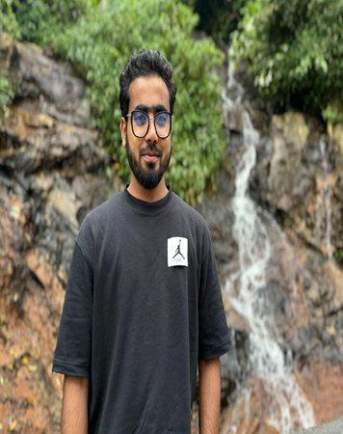
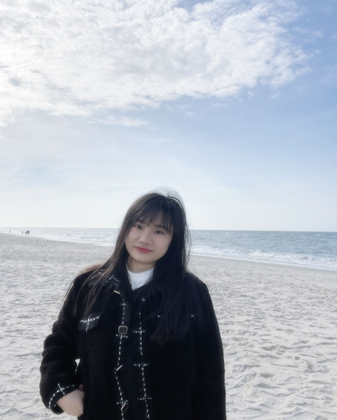
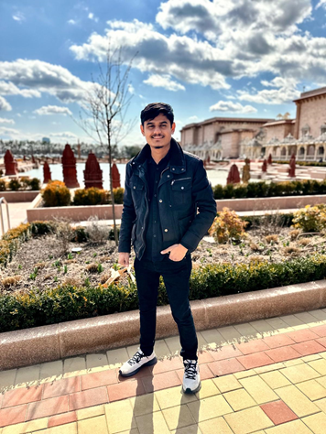
Roles and Responsibilities
MOHAMMED TANZIL
DEVELOPER/TESTER
BANGLING YIN
DEVELOPER
ABHIKUMAR PATEL
DEVELOPER/TESTER

Slide 5

IMPROVEMENTS
Historical Velocity Chart (slide 72) and Committed Ratio (slide 74)
Removed a technical story of creating user stories from Product Backlog. (slide 53)

Slide 6
WHAT PROBLEM ARE WE SOLVING?
Accurate and timely diagnosis of skin diseases is a challenge because:
Limited availability of dermatologists in remote areas
Traditional methods primarily involve only visual inspection of the skin which may be prone to human error or variability in interpretation.
What does it affect?
This results in delayed diagnosis, limited personal care and possibly worsening of skin diseases.

Slide 7
PROJECT DESCRIPTION
A web-based platform to help patients diagnose skin conditions using deep learning.
Intended for patients who wants to quickly access their skin conditions, skinLens integrates image analysis to provide accurate diagnosis of skin diseases and recommend treatments.
Intended for dermatologists who wants to efficiently access patient’s skin conditions.
Unlike traditional visual inspections, SkinLens uses advanced image-based deep learning model and offers accurate predictions and recommend treatments along with real-time consultation with dermatologists.
Benefits - Improved diagnose accuracy, faster and personalized care, increased accessibility, reduced costs and real-time access to consultations with dermatologists.

Slide 8
PROJECT DESCRIPTION
Project Name: | SkinLens
Team: | Team Biased
Project Description: | For patients who wants to quickly access their skin conditions, for dermatologists who wants to quickly access patient’s skin conditions SkinLens is a web application that integrates image analysis to provide accurate diagnosis of skin conditions and recommend treatments along with real-time consultation with dermatologists. Unlike traditional visual inspections, SkinLens uses advanced image-based deep learning model and offers accurate predictions and recommend treatments.
Benefit Outcomes: | Improved diagnose accuracy, Faster and personalized care, Increased accessibility, Reduced costs, Real Time consultation with Dermatologist.
GitHub Link: | https://github.com/htmw/2024F-Biased/wiki

Slide 9
Team Working Agreement
Communication expectations
Meeting structure and frequency
Meetings will be held via zoom
Daily scrum at 8pm for 15 minutes.
A follow-up meeting should be planned after the daily scrum if there are any blockers that can’t be addressed quickly.
A meeting for Sprint Planning will be planned at the beginning of the Sprint.
A meeting for Sprint Retrospective will be planned before the Sprint end date.
Encourage everyone to actively participate in the meeting.
We will adhere to agreed meeting time and will inform the team of any absences.
Any changes in the timings will be mutually decided.
Meeting minutes with objectives and decisions will be recorded in a Google Sheet.
If you miss a meeting, support decisions made in your absence.
Scrum Master should host the meeting and control time.
All communications will be through Slack.
Opinions and ideas of all team members will be respected.
Changes, if any, should be discussed and agreed within the team.
Conflicts should be focused on issues and not individuals. (Strictly avoid blame game)
Unresolved conflicts among the team should be reported to the team leader.
We encourage everyone to express their frustrations and discomfort early.
Clear understanding and listening to others are the most important things to resolve conflicts.

Slide 10
Team Working Agreement
Team norms and values
Continuous Improvement
Each team member understands their roles and responsibilities.
We divide tasks transparently and help each other when necessary.
Each task should have a clear due date and mutually accepted definition of “Done”.
Each team member takes responsibility for their tasks and for achieving the team's goals.
Team members should report obstacles immediately if they cannot complete their work on time, and actively contribute to the solution.
Team members should update their task’s process via Jira before the daily scrum meeting.
Team members should upload their work to prescribed places like GitHub or Google Drive before the daily scrum meeting.
Encourage teams to research, learn, come up with new ideas and share with the team.
We will reflect on areas of improvement during each Sprint Retrospective so that our process is better for the next sprint.
Definition of DONE
Work has been fully reviewed by another team members.
Code can run and no errors.
All tests are successfully completed.
No critical defects.
Work meets the acceptance criteria.
Code pushed to GitHub.
Documentation has been updated.

Slide 11
Project Schedule
Sprint 0
Sprint 1
Sprint 2
Sprint 3
Sep 6 - Sep 26
Sep 26 - Oct 24
Home page
Upload image
AI prediction
Oct 24 - Nov 21
More conditions
More accuracy
Disease description
Treatment recommendations
Generate report
Users account
Technical paper
Nov 21 - Dec 12
More accuracy
Patient records
Dermatologist dashboard
Dermatologist review
Chat
User Manual
Deployment Manual
API Manual

Slide 12
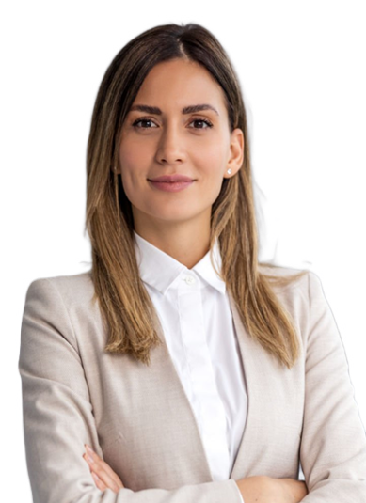
PATIENT PERSONA
Nashley is a busy professional person, living in a city and has sensitive skin prone to rash and acne.
Challenges:
She has skin issues and often experiences delays in scheduling appointments with dermatologists.
Finds very difficult to describe disease accurately and fears misdiagnosis due to lack of knowledge.
Concerned about long-term skin damage and wants fast treatment options.
Goals:
She wants a reliable, easy-to-use platform to self-access skin issues quickly and get initial feedback without needing to wait for appointments.
Hopes to receive personalized treatment recommendations based on her skin type, age, and medical history.
Nashley Pagiroli
Age: 30
Gender: Female Occupation: IT Employee

Slide 13

PARENT PERSONA
Gloria is a housewife balancing taking care of four children,household duties, and her husband,leaving her with little time to focus on individual healths.
Challenges:
Frequently deals with minor skin issues like rashes or eczema among her kids.
Finds to gets confused especially when it comes to skincare for different ages and skin types.
Concerned about the cost and time required for multiple doctor visits, particularly for non-serious conditions.
Goals:
Seeks personalized advice for each children skincare with their unique needs like skin type, allergies, or past treatments.
Hopes to save time by using images and she uploads.
Wants peace of mind by receiving accurate, clear advice and thinks homecare is sufficient.
Gloria Garson
Age : 40
Gender : Female Occupation : House wife

Slide 14

DOCTOR PERSONA
Dr. Robert is working in both a hospital and private clinic, treating a high volume of patients with various skin conditions.
Challenges:
Manages a large patient load daily, leading to limited time for each consultation and difficulty providing personalized care.
Often receives incomplete descriptions of diseases, making it challenging to diagnose accurately without further testing or follow-ups.
Struggles to track patient treatment outcomes over time,like eczema or psoriasis, due to irregular follow-ups or inconsistent data from patients.
Goals:
Wants a platform of patient information, including images, and medical history, allowing for quick.
Hopes to tracks patient progress over time, helping to adjust treatments.
Aims to reduce the patient times.
Dr. Robert Smith
Age : 35
Gender : Male
Occupation : Dermatologist

Slide 15
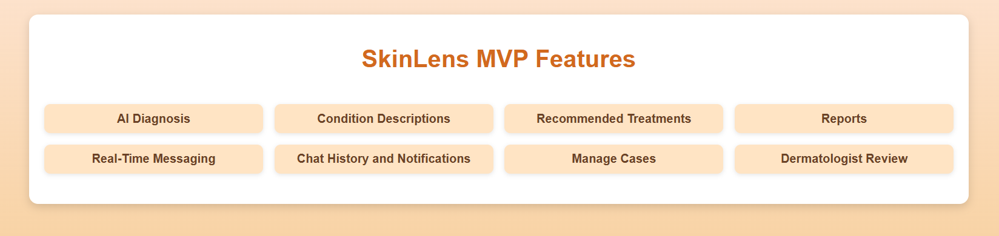
MVP (Minimum Viable Product)

Slide 16
MVP (Minimum Viable Product)
Web-Based Interface:
User-friendly platform accessible to patients and dermatologists.
Patient Image Upload:
Secure and intuitive feature for patients to upload skin condition images.
Supports multiple images per case for comprehensive analysis.
AI-Powered Diagnosis:
Utilizes a pre-trained image classification model to process uploaded images.
Provides fast and accurate diagnosis results for 20+ skin conditions.
Diagnosis Display:
Clear and concise results displayed to the patient with an option to generate report, including:
Predicted skin condition.
Brief description of the diagnosis.
Actionable treatment recommendations.
Reports
Generate PDF reports for cases.
Downloadable and secure report access.
Chat
Real-time messaging with dermatologists.
Manage patient chats seamlessly.

Slide 17
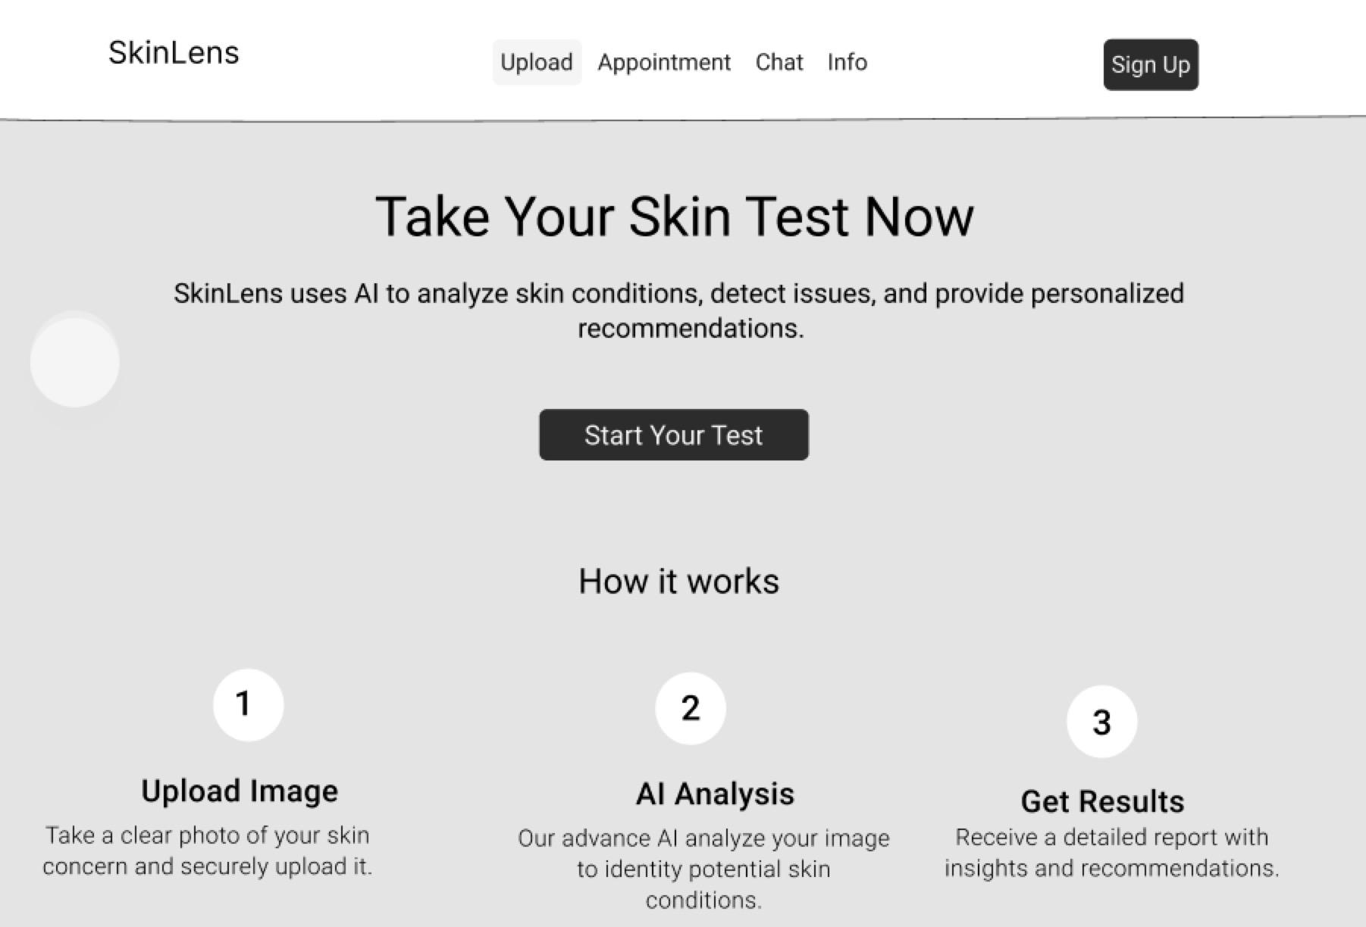
Project Design (Figma)

Slide 18
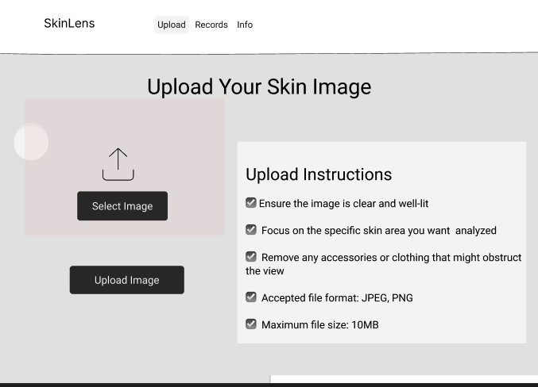
Project Design (Figma)

Slide 19
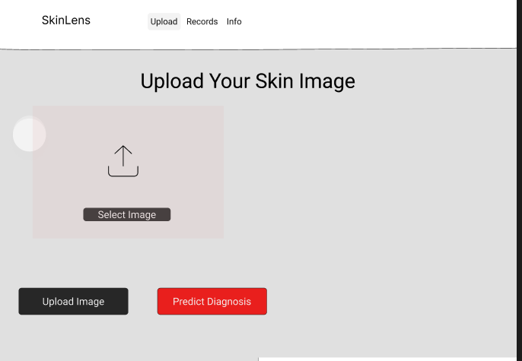
Project Design (Figma)

Slide 20



















Technologies
Front-end & Back-end & Database
AI Model
Tools

Slide 21

REACT+VITE AND TAILWIND CSS
REACT: It is an open source JavaScript library.
It used to create interactive and reactive user interfaces. We can split UI’s into reusable components, which can make it easier to maintain and build large web applications.
VITE: It is a fast and good web application build tool. It stands out for its fast startup and instant compilation times during development.
TAILWIND CSS: It is an open source css framework.
It encourages a more direct approach to styling.

Slide 22

FLASK
SkinLens utilizes a flask-backend server.
Integration with AI Model
Flask is used exclusively to host and manage the TensorFlow-based image classification model.
Processes image data sent from the frontend and returns accurate diagnoses for over 20 skin conditions.
Acts as a middleware to handle communication between the React frontend and the AI model.
REST API for Predictions
Provides a dedicated API endpoint for uploading images and receiving AI-generated diagnoses.
Handles data preprocessing before sending it to the model and ensures smooth response delivery.
Lightweight and Efficient
Flask's lightweight framework ensures quick deployment and efficient handling of AI model requests.
Keeps the architecture modular by separating AI-related operations from other backend functionalities.

Slide 23
FIREBASE INTEGRATION IN SKINLENS
5. Real-Time Features
Provides real-time updates for patient case statuses and dermatologist comments.
Supports real-time chat between patients and dermatologists for instant consultation.
Ensures real-time notification alerts for case updates and new messages.
Why Firebase?
Simplifies backend management with an all-in-one platform for authentication, storage, and database operations.
Provides robust security measures for healthcare data while meeting privacy standards.
Offers seamless real-time data updates for enhanced user experience.
Ensures high reliability, scalability, and minimal maintenance effort, making it ideal for healthcare applications.

Slide 24
CORS
Axios
Cross Origin Resource Sharing
Security Feature: Prevents web pages from making requests to a different domain than the one serving the web page.
Handling Cross-Origin Requests: Needed to enable requests from the frontend (React) to the backend (Flask), especially when hosted on different servers or ports.
Flask-CORS: A Flask extension used to handle CORS settings, allowing the frontend to securely access the API.
Configuration: Configured in the Flask app to allow requests from the frontend domain, specifying allowed HTTP methods (GET, POST, etc.)
JavaScript HTTP Client: Axios is a promise-based library used to make HTTP requests from the frontend (React).
Simplifies API Calls: Handles API requests (GET, POST) and responses for operations like uploading images and retrieving diagnoses.
Error Handling: Provides built-in support for handling errors and network issues in the API requests.
Asynchronous Operations: Supports asynchronous requests, allowing the app to remain responsive while waiting for the backend to process data.

Slide 25
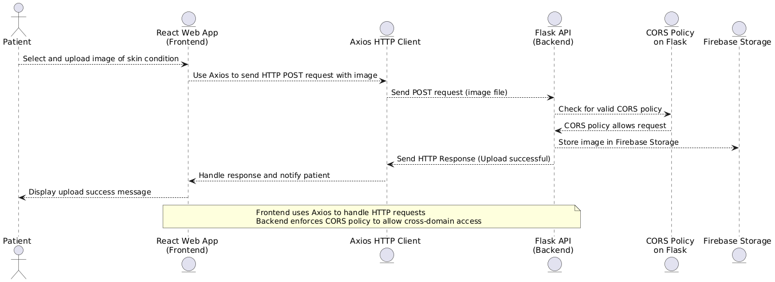
CORS and Axios functioning

Slide 26

FIREBASE INTEGRATION IN SKINLENS
Key Features of Firebase in SkinLens:
Authentication
Enables secure login and signup for patients and dermatologists.
Role-based authentication controls access to specific dashboards, cases, and reports.
Ensures seamless user management with email/password and token-based authentication.
Firestore Database
Stores user profiles, including name, email, role, and unique user IDs (UIDs).
Maintains detailed case records, including metadata, AI predictions, descriptions, and treatment recommendations.
Tracks case statuses (e.g., open, reviewed) and supports real-time data synchronization for accurate updates.
Firebase Storage
Securely stores patient-uploaded skin condition images.
Organizes files by unique case IDs, ensuring easy access and retrieval for analysis and report generation.
Security & Scalability
Leverages Firebase's built-in security rules to protect sensitive patient and dermatologist data.
Automatically scales to handle high traffic, large datasets, and concurrent user sessions without performance issues.

Slide 27
ALGORITHMS:
Used TensorFlow and keras for the CNN Model and Data Augmentation.
OpenCv library for image preprocessing.
Matplotlib for visualization.

Slide 28
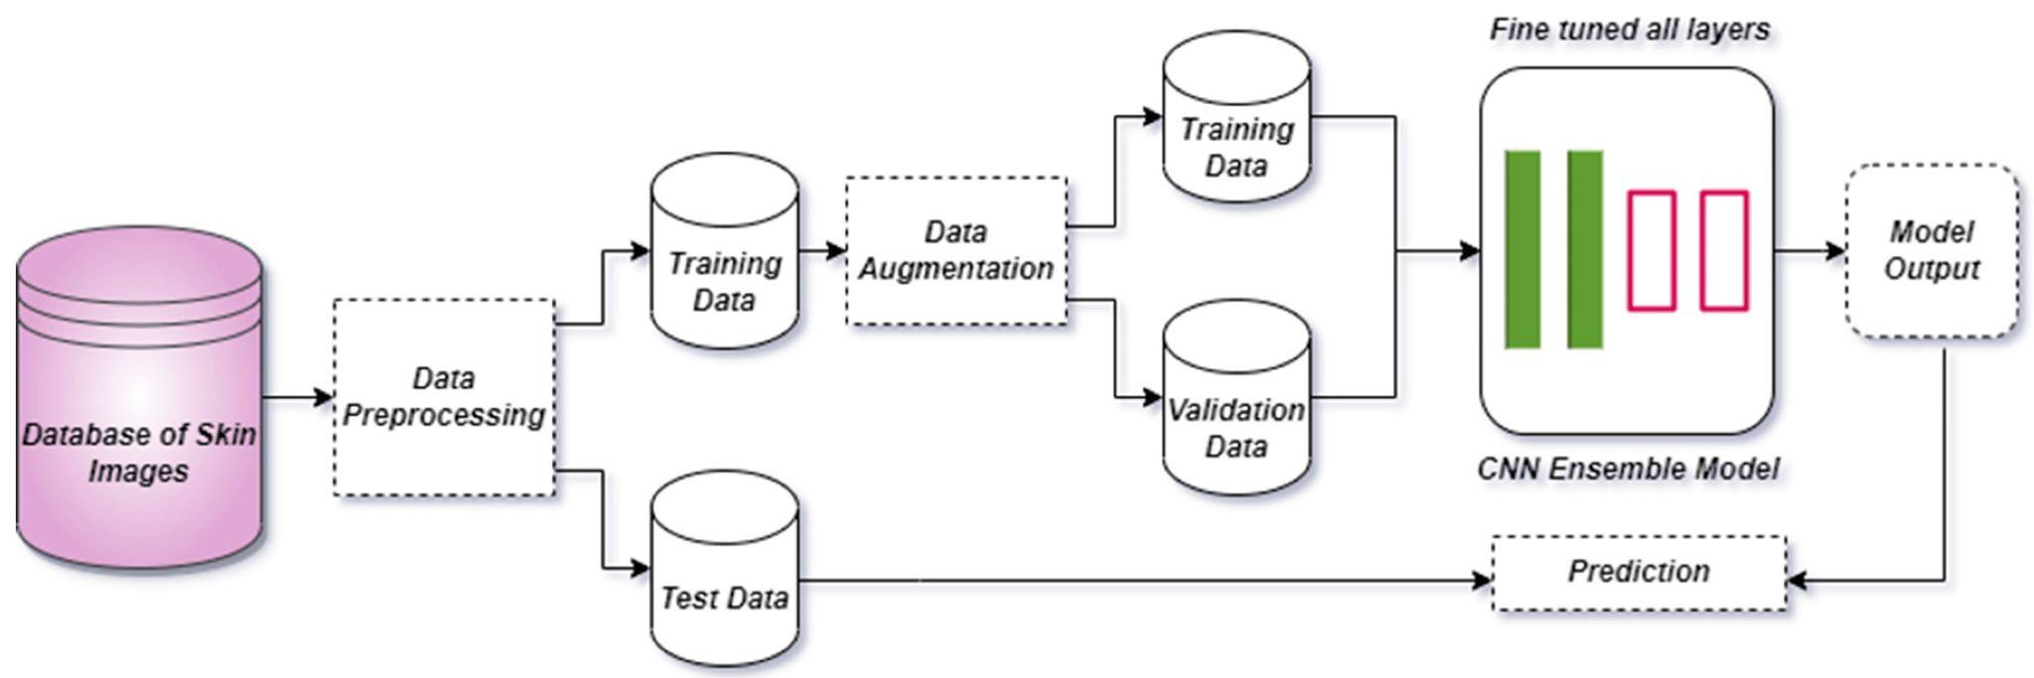
System Architecture

Slide 29
CNN Architecture:
Model Layers:
Convolutional Layers: These layers extract features like edges, textures, and shapes from the images.
Max Pooling: These layers reduce the spatial dimensions of the feature maps, making the model more efficient and reducing overfitting.
Dropout: Randomly sets some neurons to zero during training to prevent overfitting.
Flatten Layer: Converts the 3D feature maps into a 1D vector, preparing it for the fully connected layers.
Dense Layer: The final output layer that classifies the images into one of the 5 classes using softmax activation.
Batch Normalization:Normalizes the output from the convolutional layer to stabilize and accelerate training.
Softmax Activation :The softmax function converts the raw output scores into probabilities. It ensures that the sum of the output probabilities for all classes equals 1, making it suitable for multi-class classification.
Key Parameters:
Optimizer: Adam.
Loss Function: Categorical Cross-entropy (for multi-class classification).

Slide 30
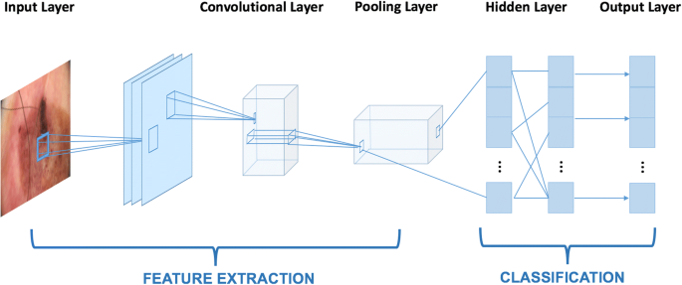
Model Structure

Slide 31
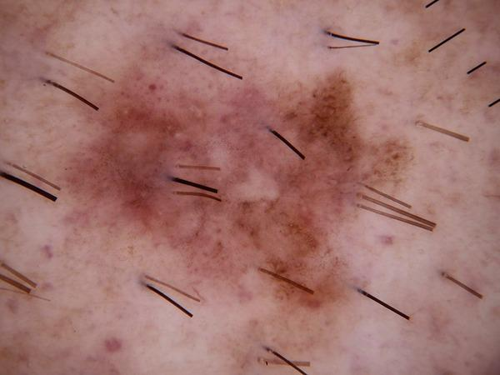
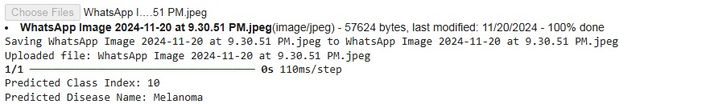
Model Testing:

Slide 32
Diagrams

Slide 33
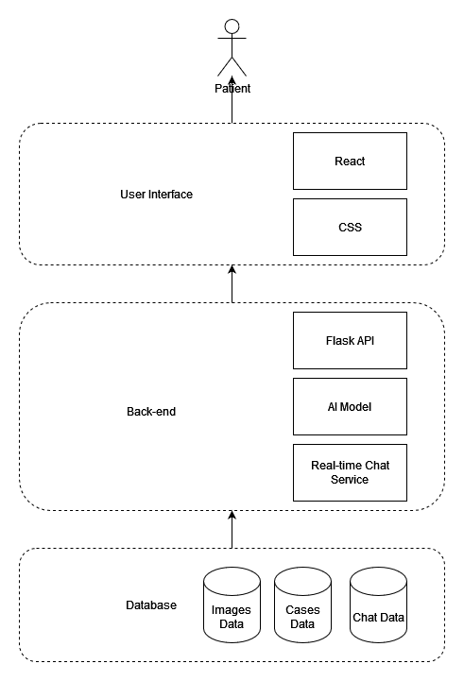
Architecture Diagram

Slide 34
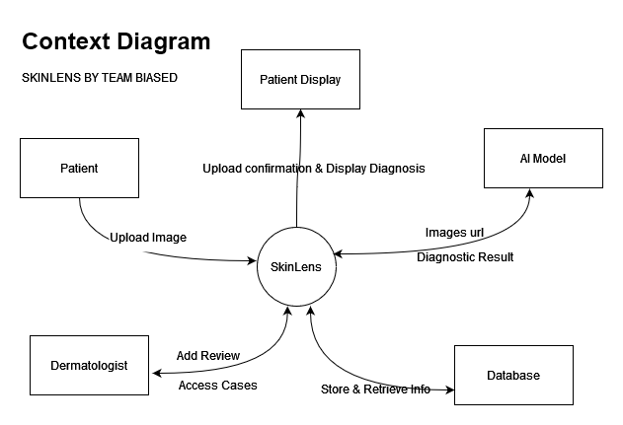
Context Diagram

Slide 35
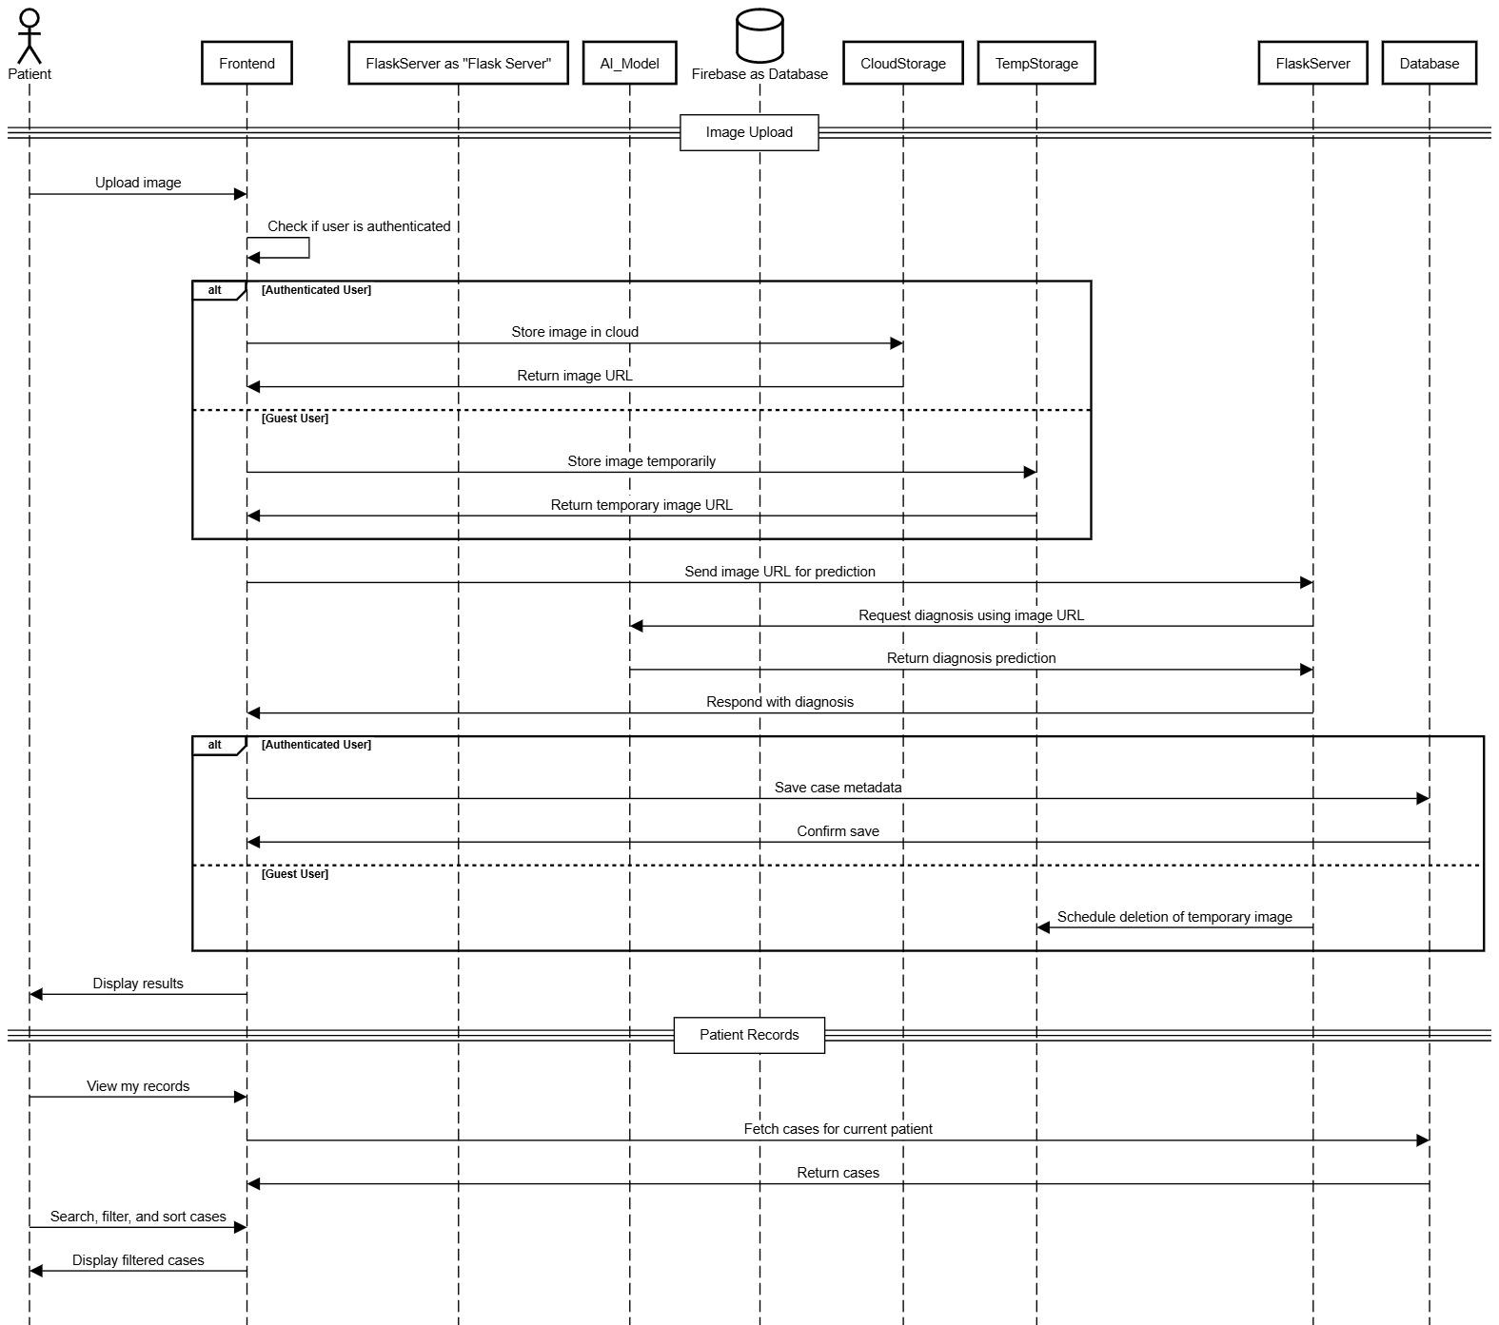
Sequence Diagram

Slide 36
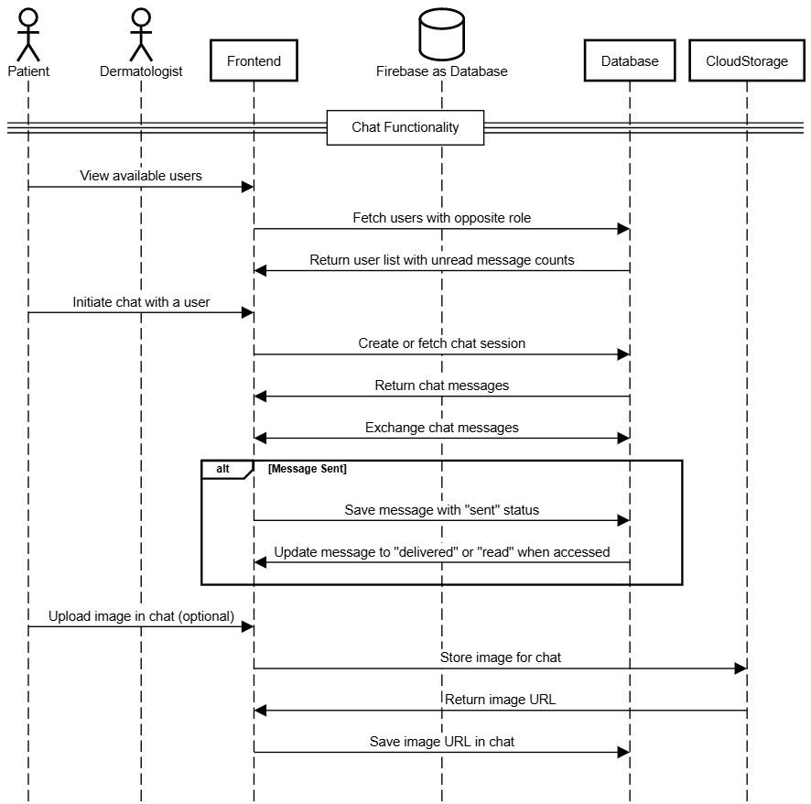
Sequence Diagram

Slide 37
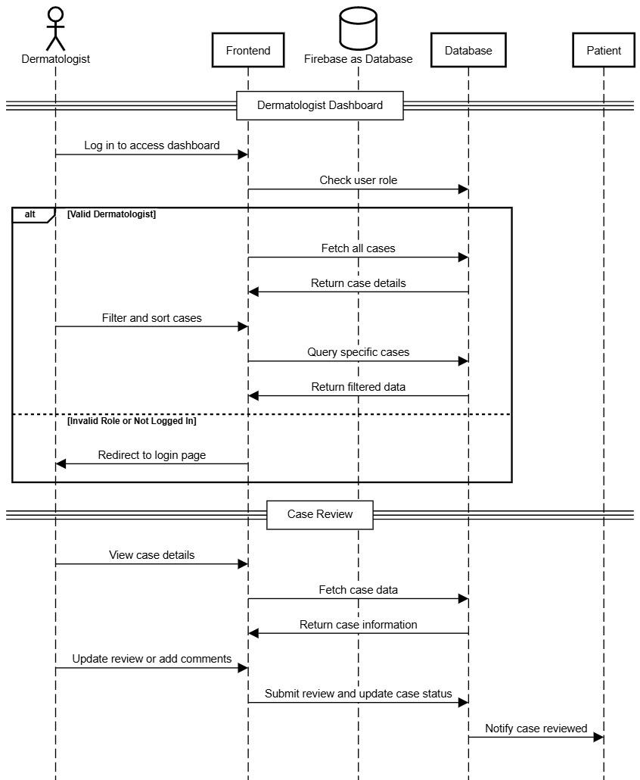
Sequence Diagram

Slide 38
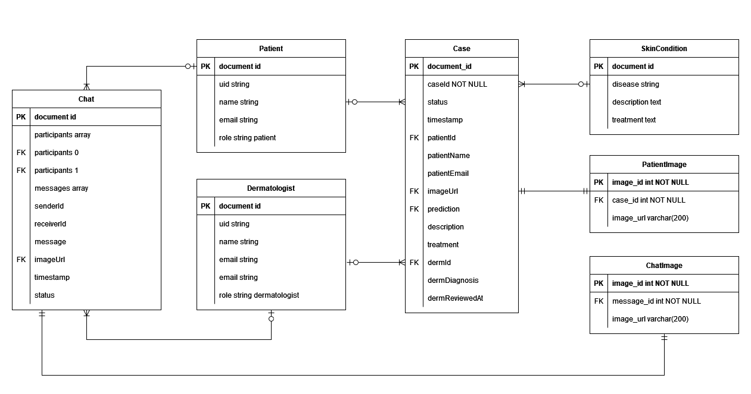
ER Diagram

Slide 39
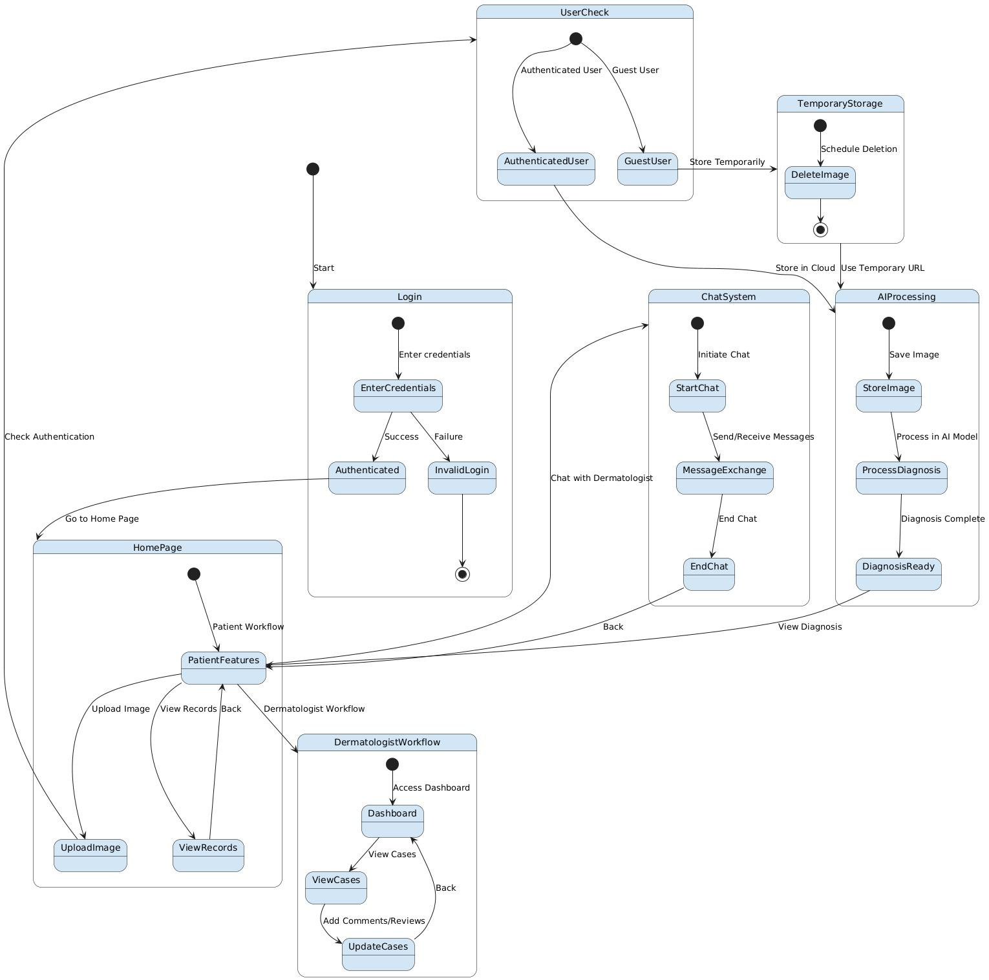
State Diagram

Slide 40
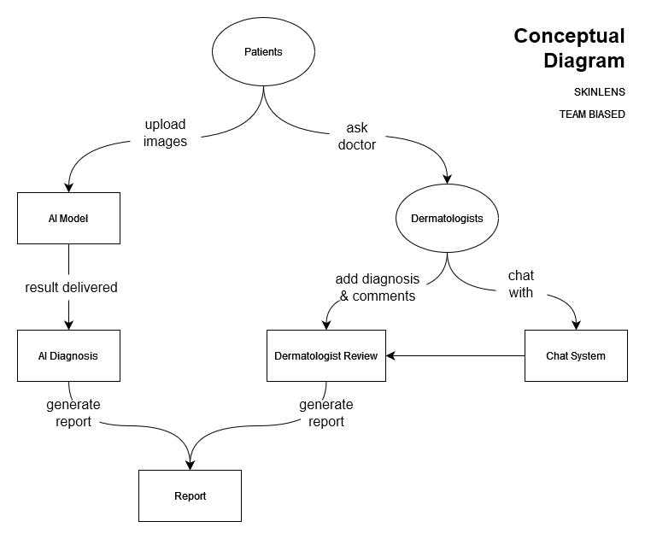
Concept Diagram

Slide 41
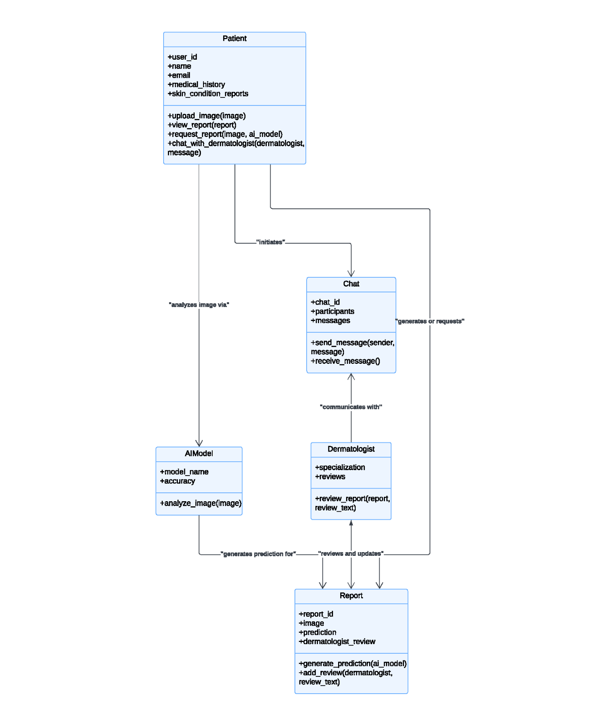
Class Diagram

Slide 42
Sprint 2 Recap
Extended the number of the skin conditions APP can recognize.
Created Firebase Storage to store images.
Created Firestore Database to store cases.
Added brief description and treatment recommendations when patient got the diagnosis.
Developed the report feature, so that patient can review and download report.
Developed the sign up and log in pages, and created Firebase to store users account.

Slide 43
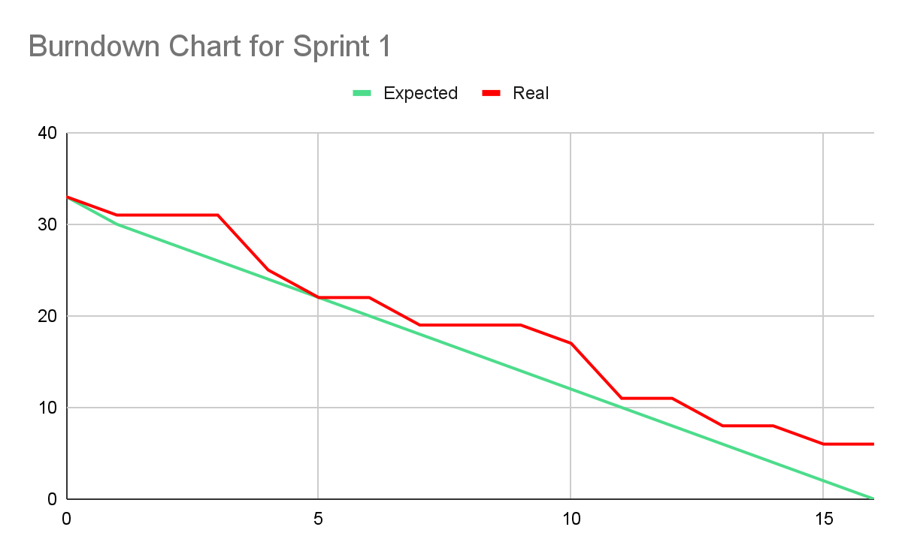
Sprint 1 Summary - BURNDOWN CHART

Slide 44
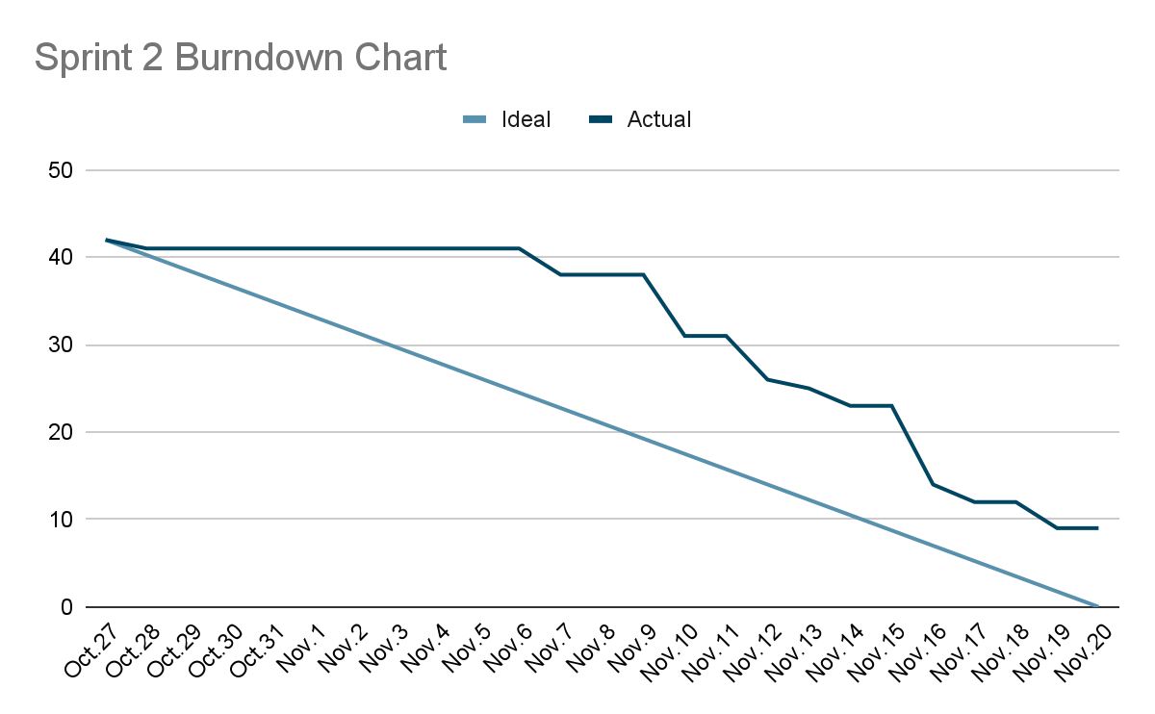
Sprint 2 Summary - BURNDOWN CHART

Slide 45
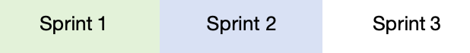
PRODUCT BACKLOG
No. | User Stories | Acceptance Criteria | Feature | Story Points
US_01 | As a patient, I want to access a home page and start a new case so that I can begin my skin condition assessment. | Access Home Page: Given the patient opens the application, When they navigate to the home page, Then the home page is displayed with options to start a new case and clear instructions on how to use the app. Start New Case Button: Given the patient is on the home page, When they click the "Start New Case" button, Then they are directed to the new case interface. | Image Upload | 2
US_02 | As a patient, I want to access an interface to upload images so that I can provide information about my skin condition. | Access Upload Interface: Given the patient starts a new case, When they proceed to the image upload step, Then an interface appears where they can upload images. Image Selection Options: Given the patient is on the image upload interface, When they choose to upload an image, Then they can either select an image from their device or drag and drop it onto the upload section. | Image Upload | 5
US_03 | As a patient, I want to select an image from my device and upload it so that it can be used for diagnosis. | The patient can select a single image file from their device. The system accepts specified formats (e.g., JPEG, JPG, PNG). | Image Upload | 5
US_04 | As a patient, I want to receive a confirmation message and see a preview of my uploaded image so that I know it was uploaded successfully. | Confirmation Message: Given the patient uploads an image successfully, When the system completes the upload process, Then a confirmation message is displayed on the screen. Image Preview: Given the image is uploaded successfully, When the system processes the image, Then a thumbnail preview of the uploaded image is displayed on the interface. | Image Upload | 2

Slide 46
PRODUCT BACKLOG
No. | User Stories | Acceptance Criteria | Feature | Story Points
US_05 | As a patient, I want the app to analyze my image and recognize basic types of skin conditions so that I can receive a preliminary diagnosis. | Model Triggers Analysis: Given the patient has successfully uploaded an image, When they click the "Analyze" button, Then the app uses the trained AI model to classify the skin condition. Initial Classification Accuracy:Given the model is trained to recognize 5 common skin conditions, When an image is analyzed, Then the prediction results are displayed based on the model's classification accuracy. | AI Diagnosis | 8
US_06 | As a patient, I want to receive the diagnosis as the name of the condition so that I can understand the skin issue. | Display Diagnosis Name: Given the model completes the analysis, When a diagnosis is generated, Then the name of the skin condition is displayed clearly on the patient’s screen. Readable Format: Given the diagnosis is presented to the patient, When it is displayed, Then the name of the condition is shown in an easy-to-read and user-friendly format. | AI Diagnosis | 5
US_07 | As a patient, I want the uploaded image to be securely stored so that I can access my report anytime. | Secure Image Storage: Given the patient uploads an image, When the upload process is successful, Then the image is securely stored in Firebase Storage with a unique case ID. Image Accessibility: Given the patient has logged into their account, When they access their case details, Then all stored images are displayed and linked to the relevant case. | Image Handling | 3
US_08 | As a guest user, I want my uploaded image to be deleted after processing so that it doesn’t remain stored unnecessarily. | Automatic Deletion: Given the guest uploads an image, When 5 minutes have passed after upload, Then the image is automatically deleted from Firebase Storage. | Image Handling | 2

Slide 47
PRODUCT BACKLOG
No. | User Stories | Acceptance Criteria | Feature | Story Points
US_09 | As a guest user, I want the system to alert me if my temporary image is unavailable after the session so that I can re-upload it. | Image Unavailable Alert:Given the guest's temporary image is deleted due to timeout, When they attempt to proceed, Then the system displays an alert notifying them about the unavailability. Re-Upload Option: Given the guest's image is deleted, When they choose to upload a new image, Then the system provides an option to re-upload. | Image Handling | 1
US_10 | As a patient, I want clear error messages if something goes wrong during upload or prediction so that I can take corrective actions. | Error Messages for Uploads: Given the patient uploads an invalid file or encounters a failed upload, When the system detects an issue, Then an error message is displayed explaining the problem and steps to resolve it. Retry Options: Given an error occurs during upload or prediction, When the patient chooses to retry, Then the system provides a retry button to reattempt the process. | Image Handling | 1
US_11 | As a patient, I want the app to recognize a wide range of skin conditions so that I can receive a diagnosis for diverse issues. | Wide Range of Conditions: Given the patient submits an image, When the diagnosis is completed, Then the app provides predictions for 20+ skin conditions with clear names. | AI Diagnosis | 5
US_12 | As a patient, I want the diagnosis accuracy to be improved so that I can trust the AI’s results. | Model Accuracy Improvement: Given the AI model is retrained with additional data, When new predictions are made, Then the accuracy threshold meets or exceeds 80% for common conditions. | AI Diagnosis | 5

Slide 48
PRODUCT BACKLOG
No. | User Stories | Acceptance Criteria | Feature | Story Points
US_13 | As a patient, I want to receive the diagnosis result as soon as possible so that I can act quickly if needed. | Fast Processing Time: Given the patient uploads an image for diagnosis, When the system processes the request, Then the results are displayed within 1 minute. Delay Notification: Given processing exceeds the expected time, When the patient waits, Then the system informs them of the delay and provides an estimated wait time. | AI Diagnosis | 2
US_14 | As a patient, I want to receive a brief description of the diagnosed condition so that I can understand about the skin issue I am facing. | Brief Description:Given the diagnosis is completed, When the result is displayed, Then a brief description is provided in clear, understandable language, including common symptoms and causes. | AI Diagnosis | 2
US_15 | As a patient, I want to receive treatment recommendations so that I can take action towards treating my skin condition. | Treatment Recommendations:Given the patient receives a diagnosis, When the system displays the result, Then evidence-based treatment recommendations are provided, including over-the-counter remedies or advice to seek professional care. | AI Diagnosis | 2
US_16 | As a patient, I want to view a comprehensive report of a case so that I have a complete record of my skin condition assessment. | View Comprehensive Report:Given the patient accesses their case, When they open the report, Then it includes metadata, patient details, uploaded images, diagnosis, descriptions, and treatment recommendations. | Report | 5

Slide 49
PRODUCT BACKLOG
No. | User Stories | Acceptance Criteria | Feature | Story Points
US_17 | As a patient I want to download a detailed report as a PDF so that I can share it with a dermatologist or keep it for personal records.. | Downloadable Report: Given the patient opens their report, When they click the "Download PDF" button, Then a PDF version of the report is generated and downloaded, matching the layout of the web application. | Report | 1
US_18 | As a patient, I want the ability to print my report directly from the app so that I can have a hard copy when needed. | Print Report: Given the patient opens their report, When they click the "Print" button, Then a printable version of the report is generated with a clear and professional layout. | Report | 1
US_19 | As a patient, I want my reports to be secure and accessible only by me so that my medical data remains private. | Secure Access:Given the patient logs into their account, When they access their reports, Then the system verifies their identity and ensures only they can view the data. Data Security:Given the patient’s reports are stored, When the system handles data, Then secure storage methods like Firebase and Firestore encryption are used to ensure privacy. | Report Security and Privacy | 2
US_20 | As a patient, I want to view my past cases and track their statuses, so that I can monitor my health progress and stay informed about the evaluations. | Case History Access: Given the patient logs into their account, When they navigate to the "Case History" section, Then they can view a chronological list of all past cases. Real-Time Status Updates: Given the patient views their case list, Then the status of a case changes, Then the system updates the status in real time without requiring a refresh. Navigation to Report:Given the patient clicks on a case entry, When the system processes the request, Then the patient is navigated to that case’s report. | User Account Management | 2

Slide 50
PRODUCT BACKLOG
No. | User Stories | Acceptance Criteria | Feature | Story Points
US_21 | As a dermatologist, I want to access and view patient reports so that I can assess their conditions and provide professional feedback. | Access Reports Dashboard: Given the dermatologist logs into their account, When they navigate to the dashboard, Then a list of all assigned patient reports is displayed. Report Sorting Options:Given the dermatologist is on the reports dashboard, When they apply sorting filters (e.g., by date, status, or patient ID), Then the system dynamically updates the displayed list. | User Account Management | 2
US_22 | As a dermatologist, I want to add comments to patient reports so that I can provide additional guidance if necessary. | Add Comments: Given the dermatologist opens a patient report, When they enter comments in the designated text field, Then the comments are saved and associated with the report. Visibility of Comments: Given the dermatologist submits comments, When the patient views the report, Then the comments are displayed in the relevant section. | Derm Review | 2
US_23 | As a patient, I want to be notified as soon as my report is reviewed by a dermatologist so that I can stay informed about my case status. | Notification Delivery: Given the dermatologist submits their diagnosis and comments, When the report status changes to "Reviewed," Then the patient receives a notification. Notification Content: Given a notification is sent, When the patient opens it, Then it includes a brief message indicating the report has been reviewed and instructions on how to view the updated report. | Derm Review | 2
US_24 | As a patient, I want to access a chat interface from my report page so that I can communicate directly with a dermatologist. | Open Chat Interface: Given the patient is on their report page, When they click the "Chat" button, Then a chat window opens displaying active chat requests. | Chat | 2

Slide 51
PRODUCT BACKLOG
No. | User Stories | Acceptance Criteria | Feature | Story Points
US_25 | As a patient, I want to message my dermatologist in real time so that I can get quick answers to my questions. | Real-Time Messaging: Given a patient initiates a chat with a dermatologist, When they send a message, Then the dermatologist receives the message in real time. Chat Features: Given a chat session is active, When messages are exchanged, Then each message includes a time stamp and typing indicators. | Chat | 4
US_26 | As a patient, I want to send images to dermatologist so that I can provide additional visual information about my skin condition. | Send Images: Given the patient is in a chat session, When they select and send an image, Then the image is uploaded and displayed in the chat interface. Supported Formats:Given the patient sends an image, When the system processes the file, Then only supported formats (JPEG, JPG, PNG) are accepted. | Chat | 2
US_27 | As a patient, I want to review the chat history with my dermatologist so that I can refer back to previous discussions and recommendations. | Access Chat History: Given the patient is in an active chat session, When they open the chat interface, Then all past messages are displayed in chronological order with time stamps. | Chat | 3
US_28 | As a dermatologist, I want to chat with patients in real-time so that I can provide personalized consultation and answer their questions. | Access Active Chat Requests: Given the dermatologist logs into their account, When they navigate to the chat dashboard, Then all active chat requests from patients are displayed. Real-Time Chat: Given the dermatologist accepts a chat request, When Messages are exchanged, Then all messages include timestamps and attachments are supported. | Chat | 4

Slide 52
PRODUCT BACKLOG
No. | User Stories | Acceptance Criteria | Feature | Story Points
US_29 | As a patient, I want to sign up an account so that I can store my basic information and access personalized services. | Patient Registration:Given the patient accesses the registration page, When they enter their full name, email, password, and date of birth,Then the system creates an account upon form submission. | User Account Management | 2
US_30 | As a dermatologist, I want to sign up so that I can access patient reports and provide professional feedback. | Dermatologist Registration: Given the dermatologist accesses the registration page, When they enter their full name, email, password, and medical license number,Then the system verifies their details and creates an account. | User Account Management | 2
US_31 | As a patient, I want to log in to my account so that I can manage my cases and view diagnoses. | Patient Login: Given the patient accesses the login page, When they enter their email and password, Then the system authenticates their credentials and directs them to their dashboard. | User Account Management | 1
US_32 | As a dermatologist, I want to log in to my account so that I can manage patient reports and update case statuses. | Dermatologist Login: Given the dermatologist accesses the login page, When they enter their email and password, Then the system authenticates their credentials and directs them to their dashboard. | User Account Management | 1

Slide 53
Technical User Stories
US_ID | User Stories | Acceptance Criteria | Story Points
TU_01 | As a developer, I want to finalize project diagrams so that I have a comprehensive visual representation of the system and its components. | Architecture Diagrams, Context Diagram, ER Diagrams, Sequence Diagram, State Diagrams, Class Diagrams. | 1
TU_02 | As a developer, I want to create test cases for Sprint 1 user stories so that I can verify the initial functionality is implemented correctly. | Test cases are written for each user story included in Sprint 1. Each test case includes test objectives, preconditions, test steps, expected results, and postconditions. | 1
TU_03 | As a developer, I want to write a technical paper on the project so that I can document its technical aspects and design decisions for future reference. | The technical paper is reviewed by team members. | 3
TU_04 | As a developer, I want to create test cases for Sprint 2 user stories so that I can verify the new functionality introduced in the Sprint 2. | Test cases are written for each user story included in Sprint 2. Each test case includes test objectives, preconditions, test steps, expected results, and postconditions. | 1

Slide 54
Technical User Stories
US_ID | User Stories | Acceptance Criteria | Story Points
TU_05 | As a developer, I want to create an installation manual for the project so that users can easily set up the application in their environment. | The Installation Manual should can assist other developers to deploy this application to the production/development environment, and indicate components and tools required to setup up the environments. The installation manual is tested by a team member or tester following the instructions to ensure accuracy. | 2
TU_06 | As a developer, I want to create comprehensive API documentation so that other developers can integrate with and use the API effectively. | Documentation covers all endpoints, including request methods (GET, POST, etc.), parameters, request/response formats, and example requests. | 2
TU_07 | As a developer, I want to create test cases for Sprint 3 user stories so that I can verify the new functionality introduced in the Sprint 3. | Test cases are written for each user story included in Sprint 3. Each test case includes test objectives, preconditions, test steps, expected results, and postconditions. | 1

Slide 55
Sprint 3

Slide 56
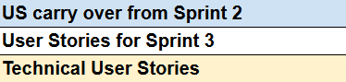
SPRINT 3 BACKLOG
US_ID | User Stories | Feature | Story Points
US_12 | As a patient, I want the diagnosis accuracy to be improved so that I can trust the AI’s results. | AI Diagnosis | 5
US_17 | As a patient, I want to download a detailed report as a PDF so that I can share it with a dermatologist or keep it for personal records.. | Report | 1
US_31 | As a dermatologist, I want to sign up so that I can access patient reports and provide professional feedback. | User Account Management | 2
US_33 | As a dermatologist, I want to log in to my account so that I can manage patient reports and update case statuses. | User Account Management | 1
US_20 | As a patient, I want to view my past cases and track their statuses, so that I can monitor my health progress and stay informed about the evaluations. | User Account Management | 2
US_21 | As a dermatologists, I want to access and view patient reports so that I can assess their conditions and provide professional feedback. | User Account Management | 2
US_22 | As a dermatologist, I want to add comments to patient reports so that I can provide additional guidance if necessary. | Derm Review | 2
US_23 | As a patient, I want to be notified as soon as my report is reviewed by a dermatologist so that I can stay informed about my case status. | Derm Review | 2

Slide 57
SPRINT 3 BACKLOG
US_ID | User Stories | Feature | Story Points
US_24 | As a patient, I want to access a chat interface from my report page so that I can communicate directly with a dermatologist. | Chat | 2
US_25 | As a patient, I want to message my dermatologist in real time so that I can get quick answers to my questions. | Chat | 4
US_26 | As a patient, I want to send images to dermatologist so that I can provide additional visual information about my skin condition. | Chat | 2
US_27 | As a patient, I want to review the chat history with my dermatologist so that I can refer back to previous discussions and recommendations. | Chat | 3
US_28 | As a dermatologist, I want to chat with patients in real-time so that I can provide personalized consultation and answer their questions. | Chat | 4
TU_05 | As a developer, I want to create an installation manual for the project so that users can easily set up the application in their environment. | Technical | 2
TU_06 | As a developer, I want to create comprehensive API documentation so that other developers can integrate with and use the API effectively. | Technical | 2
TU_07 | As a developer, I want to create test cases for Sprint 3 user stories so that I can verify the new functionality introduced in the Sprint 3. | Technical | 1

Slide 58
SPRINT 3 TEST CASES
US_12 As a patient, I want the diagnosis accuracy to be improved so that I can trust the AI’s results.
TC | TC Title | Step Description | Expected Results | Execution Status | Execution date | Tester
TC_12_01 | Validate AI Model Accuracy | 1. Input a diverse dataset with known conditions. 2. Test the model on unseen cases. | The AI model achieves a predefined accuracy threshold (e.g., >90%) on the validation dataset. | pass | Dec 12 | Tanzil
TC_12_02 | Validate Rare Case Predictions | 1. Input cases with rare conditions. 2. Check the model’s predictions. | The AI model identifies rare conditions accurately within the dataset. | pass | Dec 12 | tanzil

Slide 59
SPRINT 3 TEST CASES
US_17 As a patient, I want to download a detailed report as a PDF so that I can share it with a dermatologist or keep it for personal records..
TC | TC Title | Step Description | Expected Results | Execution Status | Execution date | Tester
TC_17_01 | Generate PDF Report | 1. Navigate to the report section. 2. Click on the "Download Report" button. | A PDF report is generated with all the relevant details (patient info, diagnosis, and recommendations). | fail | Dec 12 | Tanzil
TC_17_02 | Verify PDF Download Functionality | 1. Attempt to download the PDF report. | The PDF is downloaded successfully to the user’s device. | fail | Dec 12 | tanzil

Slide 60
SPRINT 3 TEST CASES
US_20 As a patient, I want to view my past cases and track their statuses, so that I can monitor my health progress and stay informed about the evaluations.
TC | TC Title | Step Description | Expected Results | Execution Status | Execution date | Tester
TC_20_01 | View Past Cases List | 1. Log in as a patient. 2. Navigate to the "My Cases" section. | A list of past cases with statuses is displayed. | Pass | Dec 12 | Tanzil
TC_20_02 | View Case Status | 1. Select a past case. | The case displays statuses such as "Pending", "Reviewed", or "In Progress". | pass | Dec 12 | Tanzil
TC_20_03 | Filter Cases by Status | 1. Apply a status filter (e.g., "Reviewed"). | Only cases with the selected status are shown. | pass | Dec 12 | Tanzil

Slide 61
SPRINT 3 TEST CASES
US_21 As a dermatologists, I want to access and view patient reports so that I can assess their conditions and provide professional feedback.
TC | TC Title | Step Description | Expected Results | Execution Status | Execution date | Tester
TC_21_01 | Access Patient Reports | 1. Log in as a dermatologist. 2. Navigate to the "Patient Reports" section. | A list of patient reports is displayed. | Pass | Dec 12 | Tanzil
TC_21_02 | View Patient Report Details | 1. Open a patient report. | Report displays patient details, uploaded images, and symptoms. | Pass | Dec 12 | Tanzil

Slide 62
SPRINT 3 TEST CASES
US_22 As a dermatologist, I want to add comments to patient reports so that I can provide additional guidance if necessary.
TC | TC Title | Step Description | Expected Results | Execution Status | Execution date | Tester
TC_22_01 | Add Comments to Report | 1. Open a patient report. 2. Add a comment. 3. Save the changes. | Comments are saved and visible in the report. | Pass | Dec 12 | Tanzil
TC_22_02 | Validate Comment Input | 1. Attempt to save an empty comment. | An error message prompts for valid input. | pass | Dec 12 | Tanzil

Slide 63
SPRINT 3 TEST CASES
US_23 As a patient, I want to be notified as soon as my report is reviewed by a dermatologist so that I can stay informed about my case status.
TC | TC Title | Step Description | Expected Results | Execution Status | Execution date | Tester
TC_23_01 | Receive Report Reviewed Notification | 1. Dermatologist reviews a patient’s report. | Patient receives a notification about the status update. | fail | Dec 12 | Tanzil
TC_23_02 | Notification Links to Report | 1. Click on the notification. | The corresponding report opens. | fail | Dec 12 | Tanzil
US_24 As a patient, I want to access a chat interface from my report page so that I can communicate directly with a dermatologist.
TC | TC Title | Step Description | Expected Results | Execution Status | Execution date | Tester
TC_24_01 | Access Chat Interface from Report Page | 1. Open a patient report. 2. Click on the "Chat with Dermatologist" button. | Chat interface is displayed. | Pass | Dec 12 | Tanzil

Slide 64
SPRINT 3 TEST CASES
US_25 As a patient, I want to message my dermatologist in real time so that I can get quick answers to my questions.
TC | TC Title | Step Description | Expected Results | Execution Status | Execution date | Tester
TC_25_01 | Send Messages in Real Time (Patient) | 1. Open the chat interface. 2. Send a message. | Message is delivered instantly. | pass | Dec 12 | Tanzil
TC_25_02 | Receive Messages in Real Time (Patient) | 1. Dermatologist replies to a message. | Patient sees the reply instantly. | pass | Dec 12 | Tanzil

Slide 65
SPRINT 3 TEST CASES
US_26 As a patient, I want to send images to dermatologist so that I can provide additional visual information about my skin condition.
TC | TC Title | Step Description | Expected Results | Execution Status | Execution date | Tester
TC_26_01 | Upload and Send Images | 1. Open the chat interface. 2. Upload an image. 3. Send the image. | Image is sent and visible to the dermatologist. | Pass | Dec 13 | Tanzil
TC_26_02 | Validate Supported File Formats | 1. Attempt to upload an unsupported file type. | An error message prompts to upload a valid image file. | pass | Dec 13 | Tanzil

Slide 66
SPRINT 3 TEST CASES
US_27 As a patient, I want to review the chat history with my dermatologist so that I can refer back to previous discussions and recommendations.
TC | TC Title | Step Description | Expected Results | Execution Status | Execution date | Tester
TC_27_01 | View Chat History | 1. Open the chat interface. 2. Scroll through the chat history. | Past messages and images are displayed chronologically. | Pass | Dec 13 | Tanzil
TC_27_02 | Access Chat History from Report Page | 1. Open a specific report. 2. Access the chat interface. | Chat history for the corresponding report is displayed. | Pass | Dec 13 | Tanzil

Slide 67
SPRINT 3 TEST CASES
US_28 As a dermatologist, I want to chat with patients in real-time so that I can provide personalized consultation and answer their questions.
TC | TC Title | Step Description | Expected Results | Execution Status | Execution date | Tester
TC_28_01 | Send Messages in Real Time (Dermatologist) | 1. Open the chat interface. 2. Send a message to the patient. | Patient receives the message instantly. | Pass | Dec 13 | Tanzil
TC_28_02 | Receive Messages in Real Time (Dermatologist) | 1. Patient sends a message. | Dermatologist sees the message instantly. | pass | Dec 13 | Tanzil

Slide 68
SPRINT 3 TEST CASES
US_31 As a dermatologist, I want to sign up so that I can access patient reports and provide professional feedback.
TC | TC Title | Step Description | Expected Results | Execution Status | Execution date | Tester
TC_31_01 | Verify Sign-Up Form Accessibility | 1. Navigate to the dermatologist sign-up page. 2. Check the accessibility of the form. | The sign-up form is accessible and visible. | Pass | Dec 12 | Tanzil
TC_31_02 | Validate Mandatory Fields | 1. Submit the form with missing mandatory fields (e.g., name, email, password). | An error message is displayed for missing fields. | Pass | Dec 12 | tanzil
TC_31_03 | Verify Account Creation | 1. Fill in the sign-up form with valid details. 2. Submit the form. | A new dermatologist account is successfully created. | Pass | Dec 12 | tanzil

Slide 69
SPRINT 3 TEST CASES
US_33 As a dermatologist, I want to log in to my account so that I can manage patient reports and update case statuses.
TC | TC Title | Step Description | Expected Results | Execution Status | Execution date | Tester
TC_33_01 | Verify Login Form Accessibility | 1. Navigate to the dermatologist login page. 2. Check if the login form is displayed. | The login form is accessible and visible. | Pass | Dec 12 | Tanzil
TC_33_02 | Validate Login with Correct Details | 1. Enter valid credentials. 2. Click on the "Login" button. | The dermatologist is successfully logged in and redirected to their dashboard. | pass | Dec 12 | Tanzil
TC_33_03 | Verify Role-Based Access Control | 1. Log in as a dermatologist. 2. Attempt to access patient-specific features (e.g., report editing, comments). | Dermatologists can access features related to managing reports and updating case statuses. | pass | Dec 12 | Tanzil

Slide 70
SPRINT 3 STORIES COMPLETED OR NOT
US_ID | User Stories | Feature | Story Points | Completed
US_12 | As a patient, I want the diagnosis accuracy to be improved so that I can trust the AI’s results. | AI Diagnosis | 5 | Y
US_17 | As a patient, I want to download a detailed report as a PDF so that I can share it with a dermatologist or keep it for personal records.. | Report | 1 | N
US_31 | As a dermatologist, I want to sign up so that I can access patient reports and provide professional feedback. | User Account Management | 2 | Y
US_33 | As a dermatologist, I want to log in to my account so that I can manage patient reports and update case statuses. | User Account Management | 1 | Y
US_20 | As a patient, I want to view my past cases and track their statuses, so that I can monitor my health progress and stay informed about the evaluations. | User Account Management | 2 | Y
US_21 | As a dermatologists, I want to access and view patient reports so that I can assess their conditions and provide professional feedback. | User Account Management | 2 | Y
US_22 | As a dermatologist, I want to add comments to patient reports so that I can provide additional guidance if necessary. | Derm Review | 2 | Y
US_23 | As a patient, I want to be notified as soon as my report is reviewed by a dermatologist so that I can stay informed about my case status. | Derm Review | 2 | N

Slide 71
SPRINT 3 STORIES COMPLETED OR NOT
US_ID | User Stories | Feature | Story Points | Completed
US_24 | As a patient, I want to access a chat interface from my report page so that I can communicate directly with a dermatologist. | Chat | 2 | Y
US_25 | As a patient, I want to message my dermatologist in real time so that I can get quick answers to my questions. | Chat | 4 | Y
US_26 | As a patient, I want to send images to dermatologist so that I can provide additional visual information about my skin condition. | Chat | 2 | Y
US_27 | As a patient, I want to review the chat history with my dermatologist so that I can refer back to previous discussions and recommendations. | Chat | 3 | Y
US_28 | As a dermatologist, I want to chat with patients in real-time so that I can provide personalized consultation and answer their questions. | Chat | 4 | Y
TU_05 | As a developer, I want to create an installation manual for the project so that users can easily set up the application in their environment. | Technical | 2 | Y
TU_06 | As a developer, I want to create comprehensive API documentation so that other developers can integrate with and use the API effectively. | Technical | 2 | Y
TU_07 | As a developer, I want to create test cases for Sprint 3 user stories so that I can verify the new functionality introduced in the Sprint 3. | Technical | 1 | Y

Slide 72
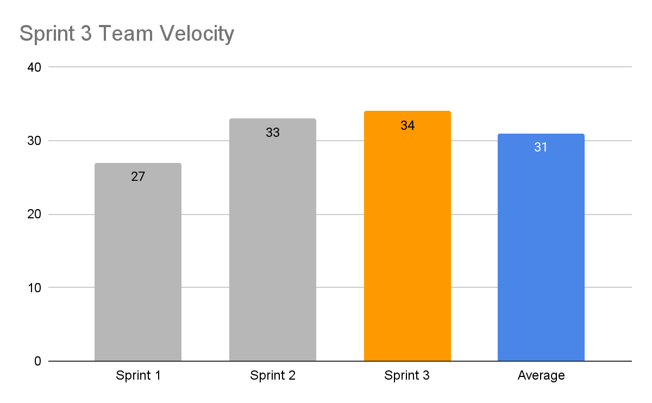
Sprint 3 METRICS - Team Velocity
Team velocity of Sprint 3: 34 story points
Team velocity of Average: 31 story points

Slide 73
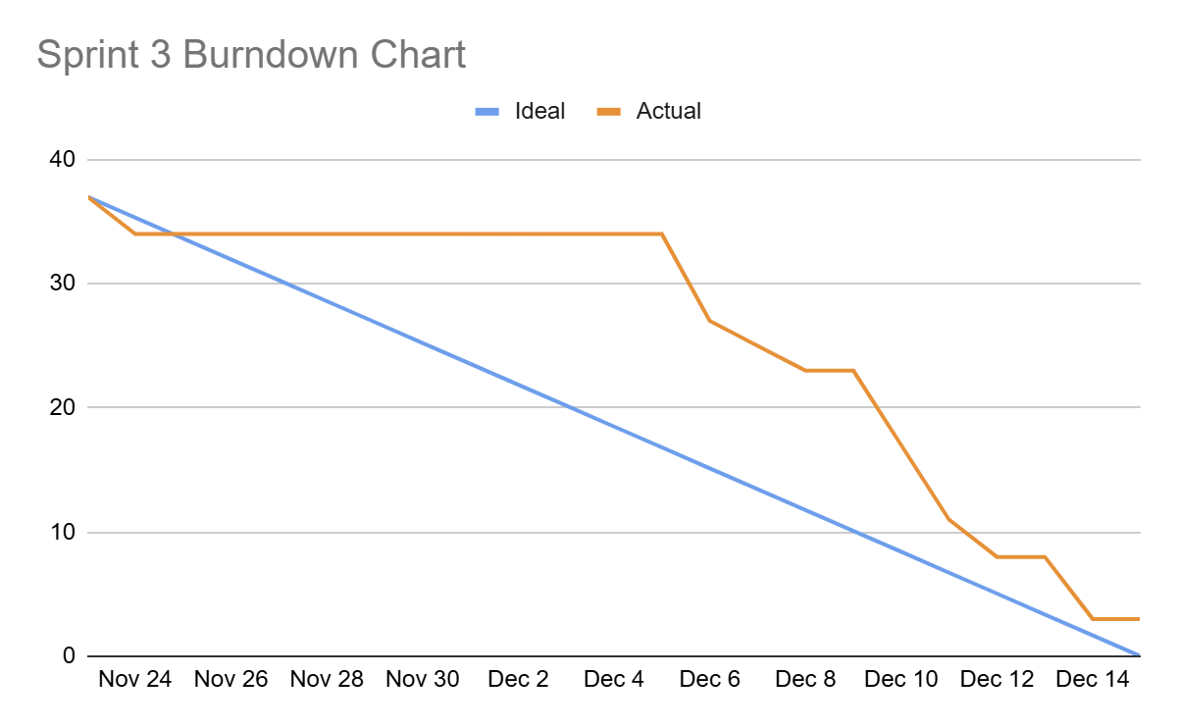
Sprint 3 METRICS - BURNDOWN CHART

Slide 74
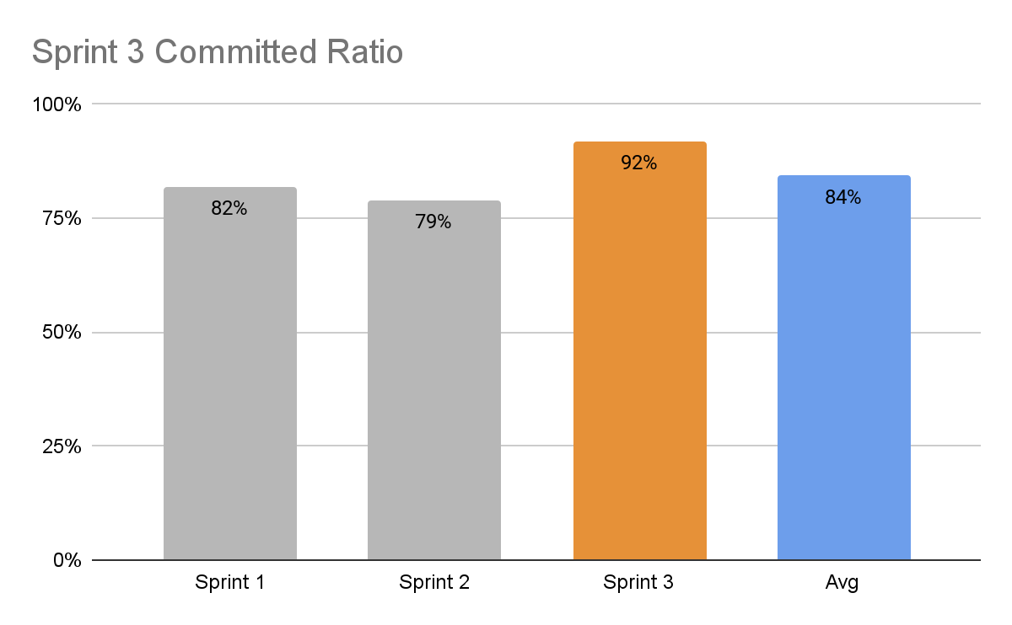
Sprint 3 METRICS - COMMITTED RATIO
Committed Ratio of Sprint 3 is 92%.
We completed 34 story points as 37 committed.

Slide 75
Sprint 3 Retrospective

Slide 76
Few important points from the Retrospective
What did we do right?
Brainstorming ideas in each step of project went well
User stories and tasks were well-defined, so each team member understood their responsibilities and deliverables
Implemented the user friendly interface for all users, guest, patient and dermatologist.
Everybody work really hard even to midnight /before dawn.
Willing to accept advice and changes
Good management of work from team leader and scrum master led to success of MVP

Slide 77
Few important points from the Retrospective
If we were to do it again, what would we do differently?
If we were to do it again, we would have prioritized the task on deciding the final dataset
We would take up responsibility of the assigned part, that is propose at least an alternative if the assigned task cannot be done.
Watch Demo together and ask for everyone's feedback after the new feature development.
Actively seeking for solution and actions together when project facing obstacles, even if not their tasks.
Do research more deeply, download previous model and test at the beginning, learn some deeper algorithms and principle.

Slide 78
Few important points from the Retrospective
Action items
If we were to do it again, we would have prioritized the task on deciding the final dataset. Assigned to Zaid - prioritize the tasks in the planning meeting
We would take up responsibility of the assigned part, that is propose at least an alternative if the assigned task cannot be done. Assigned to everyone- Come with alternate solutions and discuss with the team
Watch Demo together and ask for everyone's feedback after the new feature development. Assigned to Everyone: Get feedback from the team after developing a feature
Actively seeking for solution and actions together when project facing obstacles, even if not their tasks. Assigned to Everyone: Let the team know if facing any issues as soon as possible
Do research more deeply, download previous model and test at the beginning, learn some deeper algorithms and principle. Assigned to everyone- Get familiar with tech stack and do more research

Slide 79
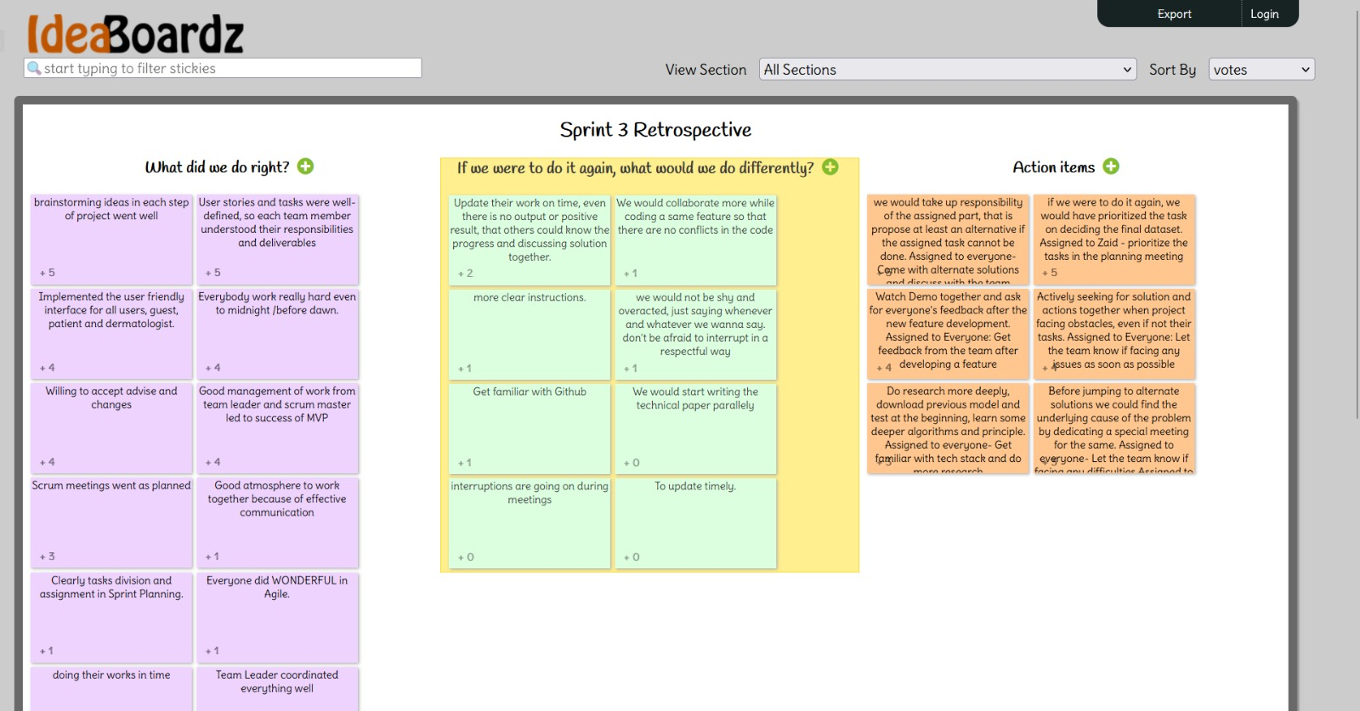
SPRINT 3 RETROSPECTIVE

Slide 80
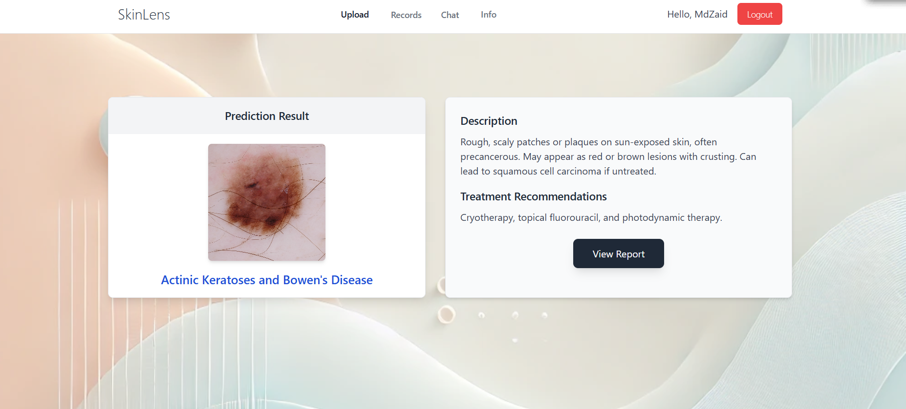
PROJECT DEMO - SCREENSHOT

Slide 81
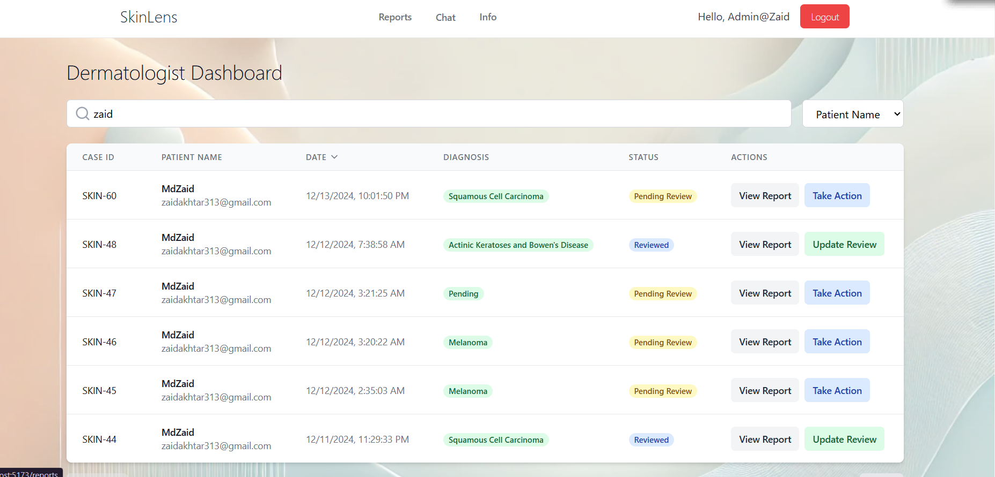
PROJECT DEMO - SCREENSHOT

Slide 82
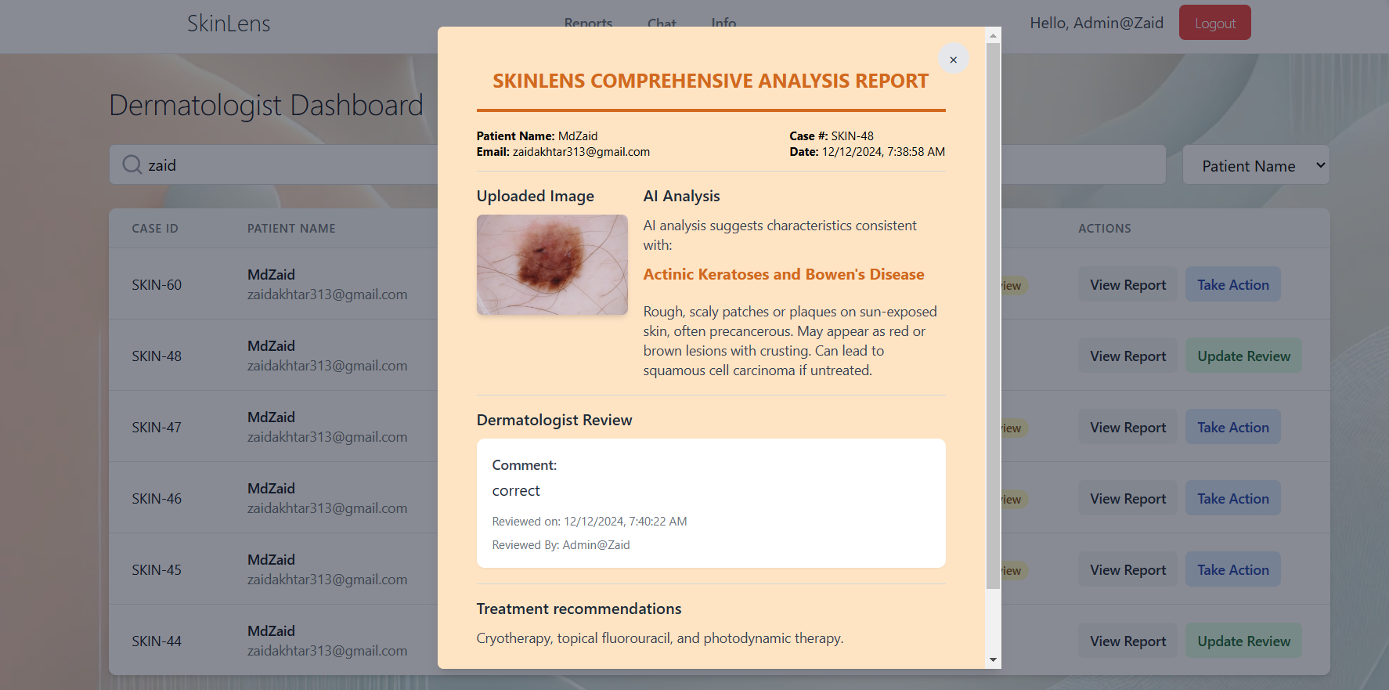
PROJECT DEMO - SCREENSHOT

Slide 83
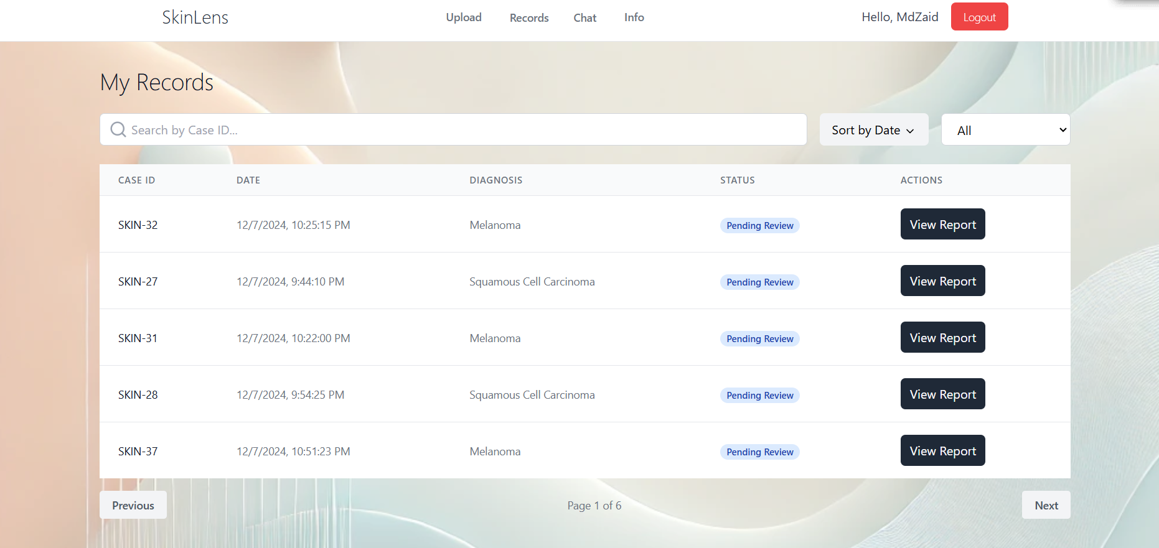
PROJECT DEMO - SCREENSHOT

Slide 84
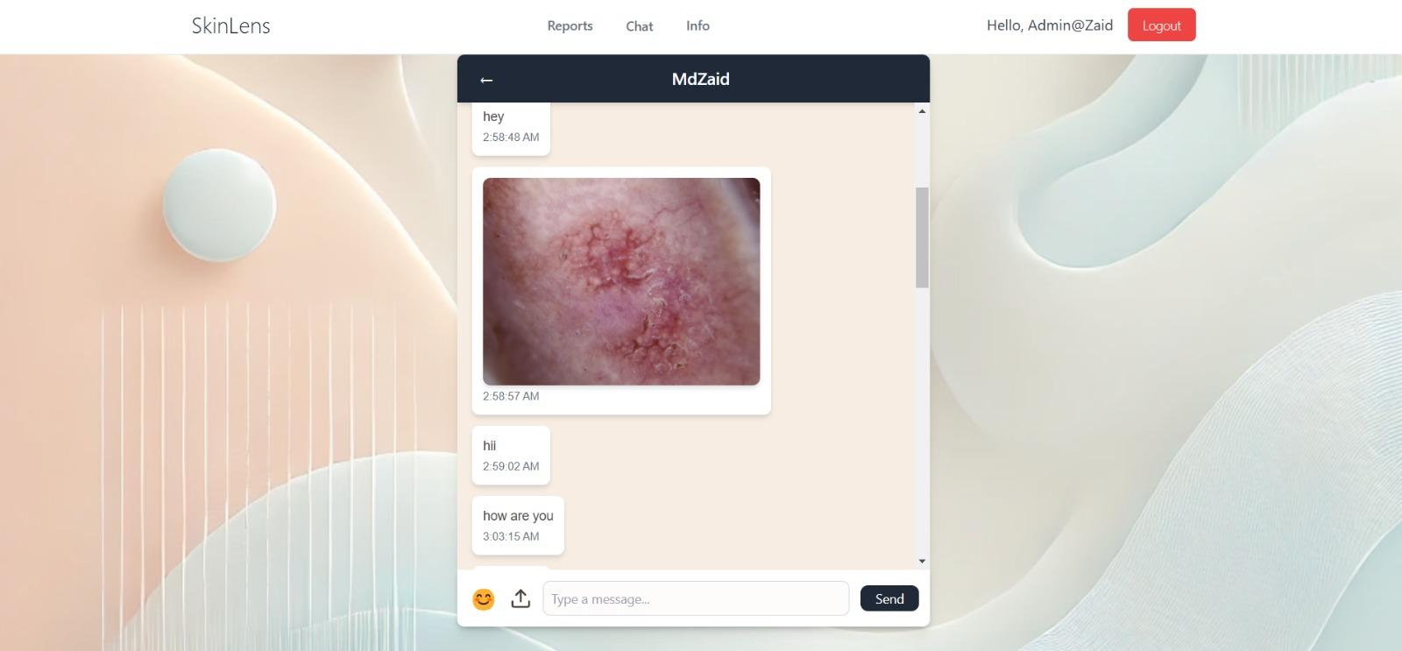
PROJECT DEMO - SCREENSHOT

Slide 85
PROJECT - APIs
1. Authentication APIs
1.1 Sign-Up API
Purpose: Creates a new user account with email, password, and additional user details in Firebase Authentication and Firestore. Method: POST via Firebase SDK. Process:
Input: User's email, password, name, and role (e.g., patient or dermatologist).
Output: A new user account is created in Firebase Authentication, and corresponding user details are stored in Firestore.
Key Code:
const userCredential = await createUserWithEmailAndPassword(auth, email, password); await setDoc(doc(db, "users", userCredential.user.uid), { name: name, email: email, role: role, uid: userCredential.user.uid, }); ​

Slide 86
PROJECT - APIs
1.2 Login API
Purpose: Authenticates the user and grants access to the application. Method: POST via Firebase SDK. Process:
Input: User's email and password.
Output: Authenticated user session and Firebase token.
Key Code:
await signInWithEmailAndPassword(auth, email, password); ​

Slide 87
PROJECT - APIs
2. Image Handling APIs
2.1 Image Upload API
Purpose: Uploads the user's image to Firebase Storage and generates a unique URL for accessing it. Method: Indirectly through Firebase Storage SDK. Process:
Input: Image file selected by the user.
Output: URL of the uploaded image.
Key Code:
const storage = getStorage(); const storageRef = ref(storage, `cases/${user.uid}/${uuidv4()}/${file.name}`); await uploadBytes(storageRef, file); const downloadURL = await getDownloadURL(storageRef); ​

Slide 88
PROJECT - APIs
2.2 Prediction API
Purpose: Sends the uploaded image to the backend for AI-based prediction and fetches the diagnosis result. Method: POST via Axios. Process:
Input: URL of the uploaded image.
Output: Predicted disease name, description, and treatment recommendations.
Key Code:
const response = await axios.post("http://localhost:5000/predict", { imageUrl }); ​

Slide 89
PROJECT - APIs
2.3 Temporary Image Deletion API
Purpose: Deletes temporary images uploaded by unauthenticated users from Firebase Storage. Method: Indirectly through Firebase Storage SDK. Process:
Input: URL of the temporary image.
Output: Deletes the image from Firebase Storage.
Key Code:
const imageRef = ref(storage, imageUrl); await deleteObject(imageRef); ​

Slide 90
PROJECT - APIs
3. Case Management APIs
3.1 Generate Case ID API
Purpose: Generates a unique case ID for each new case. Method: Programmatic generation using UUID and sequential ID logic. Process:
Input: None.
Output: A unique case ID in the format SKIN-<incremental_number>.
Key Code:
let newCaseId = "SKIN-1"; const casesSnapshot = await getDocs(collection(db, "cases")); const maxId = Math.max(0, ...casesSnapshot.docs.map(doc => parseInt(doc.data().caseId.split("-")[1]))); newCaseId = `SKIN-${maxId + 1}`; ​

Slide 91
PROJECT - APIs
3.2 Save Case Details API
Purpose: Saves case details to Firestore, including patient info, uploaded image URL, and timestamp. Method: POST via Firestore SDK. Process:
Input: Case details, including patient ID, email, image URL, and timestamp.
Output: Case document saved in Firestore.
Key Code:
await setDoc(doc(collection(db, "cases"), newCaseId), { caseId: newCaseId, patientId: user.uid, patientEmail: user.email, imageUrl: downloadURL, timestamp: new Date().toISOString(), status: "Open", }); ​

Slide 92
PROJECT - APIs
3.3 Fetch Case Details API
Purpose: Retrieves details of a specific case from Firestore. Method: GET via Firestore SDK. Process:
Input: Case ID.
Output: Case details, including patient info, image URL, and status.
Key Code:
const caseRef = doc(db, "cases", caseId); const caseData = (await getDoc(caseRef)).data(); ​

Slide 93
PROJECT - APIs
3.4 Update Case Status API
Purpose: Updates the status of a case in Firestore (e.g., from "Pending Review" to "Reviewed"). Method: PATCH via Firestore SDK. Process:
Input: Case ID and new status.
Output: Updated case document in Firestore.
Key Code:
await updateDoc(doc(db, "cases", caseId), { status: "Reviewed" }); ​

Slide 94
PROJECT - APIs
3.5 Dermatologist Comment API
Purpose: Allows dermatologists to add comments to a case. Method: PATCH via Firestore SDK. Process:
Input: Case ID and dermatologist comment.
Output: Updated case document with dermatologist's comment.
Key Code:
await updateDoc(doc(db, "cases", caseId), { dermDiagnosis: diagnosis }); ​

Slide 95
PROJECT - APIs
3.6 Fetch Reviewed By API
Purpose: Retrieves the name of the dermatologist who reviewed a case. Method: GET via Firestore SDK. Process:
Input: Case ID.
Output: Dermatologist's name.
Key Code:
const reviewedBy = (await getDoc(doc(db, "cases", caseId))).data().reviewedBy; ​

Slide 96
PROJECT - APIs
4. Chat APIs
4.1 Fetch User List API
Purpose: Retrieves a list of users available for chatting based on roles. Method: GET via Firestore SDK. Process:
Input: Current user's role.
Output: List of users with the opposite role (e.g., patients for dermatologists).
Key Code:
const userQuery = query(collection(db, "users"), where("role", "==", roleFilter)); const usersList = (await getDocs(userQuery)).docs.map(doc => doc.data()); ​

Slide 97
PROJECT - APIs
4.2 Fetch Chat Messages API
Purpose: Retrieves chat messages between two users. Method: GET via Firestore SDK. Process:
Input: Chat ID (generated by combining both user IDs).
Output: List of messages in chronological order.
Key Code:
const chatRef = doc(db, "chats", chatId); const messages = (await getDoc(chatRef)).data()?.messages || []; ​

Slide 98
PROJECT - APIs
4.3 Send Message API
Purpose: Sends a message (text or image) to another user. Method: POST via Firestore SDK. Process:
Input: Sender ID, receiver ID, message text or image URL, and timestamp.
Output: Message appended to the chat document in Firestore.
Key Code:
const messageData = { senderId: currentUser.uid, receiverId: otherUserId, message: newMessage.trim(), imageUrl, timestamp: new Date().toISOString(), status: "sent", }; await updateDoc(doc(db, "chats", chatId), { messages: arrayUnion(messageData) }); ​

Slide 99
PROJECT - APIs
4.4 Upload Chat Image API
Purpose: Uploads an image for a chat and generates a downloadable URL. Method: Indirectly through Firebase Storage SDK. Process:
Input: Image file selected by the user.
Output: URL of the uploaded image.
Key Code:
const fileRef = ref(storage, `chat-images/${chatId}/${file.name}`); await uploadBytes(fileRef, file); const imageUrl = await getDownloadURL(fileRef); ​

Slide 100
PROJECT - APIs
4.5 Update Message Status API
Purpose: Updates the status of a message (e.g., from "sent" to "delivered" or "read"). Method: PATCH via Firestore SDK. Process:
Input: Chat ID and message ID.
Output: Updated message status in Firestore.
Key Code:
const updatedMessages = messages.map(msg => msg.receiverId === currentUser.uid && msg.status === "sent" ? { ...msg, status: "delivered" } : msg ); await updateDoc(doc(db, "chats", chatId), { messages: updatedMessages }); ​

Slide 101
PROJECT - APIs
4.6 Fetch Unread Message Count API
Purpose: Fetches the count of unread messages for each chat. Method: GET via Firestore SDK. Process:
Input: Current user ID.
Output: Count of unread messages for each user.
Key Code:
const unreadCounts = messages.filter( msg => msg.receiverId === currentUser.uid && msg.status !== "read" ).length; ​

Slide 102
PROJECT - APIs
5. Report APIs
5.1 View Report API
Purpose: Fetches and displays a detailed case report. Method: GET via Firestore SDK. Process:
Input: Case ID.
Output: Case details, including patient info, uploaded image, prediction, dermatologist comment, and treatment plan.
Key Code:
const reportData = (await getDoc(doc(db, "cases", caseId))).data(); ​

Slide 103
PROJECT - APIs
5.2 Generate PDF Report API
Purpose: Generates a downloadable PDF of the case report. Method: Client-side rendering with html2canvas and jsPDF. Process:
Input: HTML element containing report details.
Output: PDF file downloaded to the user's device.
Key Code:
const canvas = await html2canvas(document.getElementById("report-content")); const pdf = new jsPDF(); pdf.addImage(canvas.toDataURL("image/png"), "PNG", 10, 10, 190, canvas.height * 190 / canvas.width); pdf.save(`SkinLens_Report_${caseId}.pdf`); ​

Slide 104
PROJECT - APIs
5.3 Fetch Disease Details API
Purpose: Retrieves the description and treatment for a specific disease. Method: GET via Firestore SDK. Process:
Input: Disease name.
Output: Disease description and treatment details.
Key Code:
const diseasesRef = collection(db, "diseases"); const querySnapshot = await getDocs(query(diseasesRef, where("disease", "==", diseaseName))); const diseaseDetails = querySnapshot.docs[0]?.data(); ​

Slide 105
PROJECT - APIs
6. Dashboard APIs
6.1 Fetch Cases for Dermatologist API
Purpose: Retrieves all cases visible to the logged-in dermatologist. Method: GET via Firestore SDK. Process:
Input: None.
Output: List of cases assigned to or available for the dermatologist.
Key Code:
const casesRef = collection(db, "cases"); const casesSnapshot = await getDocs(casesRef); const casesList = casesSnapshot.docs.map(doc => doc.data()); ​

Slide 106
PROJECT - APIs
6.2 Filter and Sort Cases API
Purpose: Filters and sorts cases based on selected criteria (e.g., date, status). Method: Client-side filtering and sorting. Process:
Input: Filter attribute, search term, and sort key.
Output: Filtered and sorted list of cases.
Key Code:
const filteredCases = cases.filter(case => case[filterAttribute]?.toLowerCase().includes(searchTerm.toLowerCase()) ).sort((a, b) => (a[sortKey] > b[sortKey] ? 1 : -1)); ​

Slide 107
PROJECT - APIs
6.3 Pagination API
Purpose: Paginates the list of cases displayed on the dashboard. Method: Client-side pagination logic. Process:
Input: Current page number and items per page.
Output: Cases for the current page.
Key Code:
const currentData = filteredCases.slice((currentPage - 1) * itemsPerPage, currentPage * itemsPerPage); ​

Slide 108
PROJECT - APIs
7. Patient Dashboard APIs
7.1 Fetch Cases for Patients API
Purpose: Retrieves all cases for the logged-in patient. Method: GET via Firestore SDK. Process:
Input: Patient ID.
Output: List of cases associated with the patient.
Key Code:
const userCases = casesSnapshot.docs.filter(doc => doc.data().patientId === user.uid); ​

Slide 109
PROJECT - APIs
7.2 Filter and Search Cases API
Purpose: Filters and searches cases for the logged-in patient. Method: Client-side filtering. Process:
Input: Search term and status filter.
Output: Filtered list of cases.
Key Code:
7.2 Filter and Search Cases API Purpose: Filters and searches cases for the logged-in patient. Method: Client-side filtering. Process: ​ Input: Search term and status filter. Output: Filtered list of cases. Key Code:

Slide 110
PROJECT - APIs
7.3 Fetch Logged-in User Data API
Purpose: Retrieves the details of the logged-in user (name, email, role). Method: GET via Firestore SDK. Process:
Input: User ID.
Output: User details from Firestore.
Key Code:
const userData = (await getDoc(doc(db, "users", user.uid))).data(); ​

Slide 111
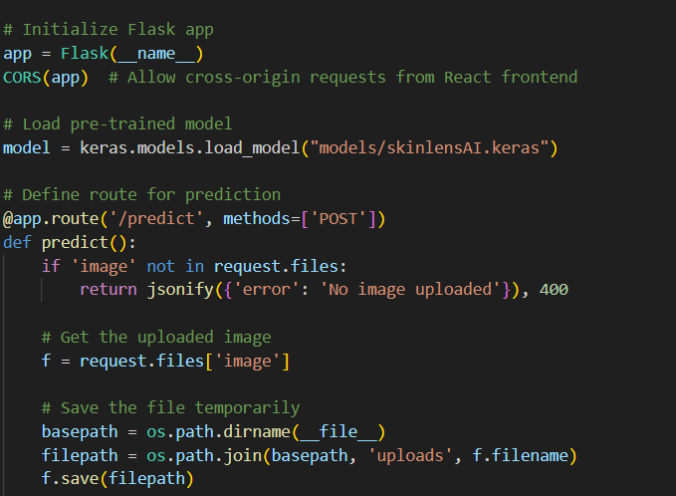
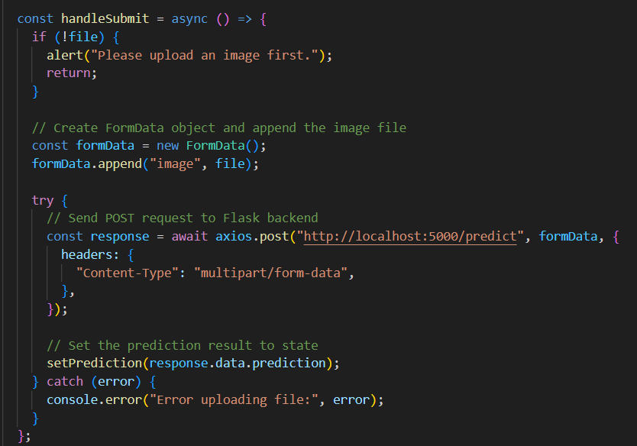
PROJECT - APIs
Flask API and CORS
Axios

Slide 112
Future Enhancement
1. Integrate multi-modal learning by combining image data with text-based inputs, such as patient-entered symptoms and clinical notes, for enhanced diagnostic accuracy.
2. Enhance chat functionality with AI-powered conversational agents to automate routine queries and improve patient response times.
3. Integrate an appointment scheduling system.

Slide 113

WIKI PAGE LINK
To see our final work,
Click on the link below.
https://github.com/htmw/2024F-Biased/wiki

Slide 114
DEMO

Slide 115
THANK YOU!

